Slide 1
Public Participation Report Quarter 2 (July – Sept 2022)
Julia Clarke – Director of Public Participation

Slide 2
Highlights of Public Participation – Q1
Community membership increased in Q2. We aim to increase our community membership by 10% year on year and are on target to achieve this.
We have continued our membership recruitment campaign with Town and Parish Councils and councillors (across Shropshire, Telford & Wrekin and Mid-Wales). We have 36 Borough and County Councillors already signed up as members. This is in addition to 180 town, community and parish councils recently recruited
The team have been supporting our Divisions with their Section 242 duties to engage the public around service changes, in Q2 this included:
ENT and Audiology
County Breast Screening Unit (Market Drayton and Bridgnorth)
Renal Dialysis, PRH
Cardiology inpatient Services
Our Engagement Team have been attending a number of events, with a particular focus on reaching our to our “hard to reach” groups within the community.
In July the volunteer team delivered a Young People’s Academy at the SECC to 20 young people aged 16-22, all of whom have an interest in pursuing a career in healthcare

Slide 3
Highlights of Public Participation – Q1
We have 294 active volunteers at the Trust.
This month the Volunteer Team have been successful in our bid to Health Education England to expand our Volunteer to Career programme, we were one of only 10 successful bids and have received £25k of funding.
This Quarter we have been preparing a volunteer recruitment and engagement campaign which will be launched at the end of September 2022. The campaign will promote Volunteering at SaTH
The new SaTH Charity CRM (Customer Relations Management software) has been implemented. This has included the creation of new online forms which link with the new software
Training sessions are being arranged for the Divisions in November on successful Charitable Fund management with Directors and the NED Chair Teresa Boughey attending
The NHS Big Tea took place on the 5th July and over £700 was raised for SaTH Charity from a cake sale, raffle and supermarket collections

Slide 4
Public Assurance Forum 3 October 2022 (1)
The Public Assurance Forum (PAF) met on 3rd October 2022, with good member representation from community members and divisional teams. Chair invited contributions from members for future agenda items
External membership of the Forum includes representatives from: Healthwatch Shropshire, Healthwatch T&W, Community Health Council, Shropshire Patient Group, Telford Chief Officers Group (COG), Telford Patient First, Maternity Voices Partnership, Shropshire Voluntary and Community Sector Assembly, Powys Association of Voluntary Organisations (PAVO), Health and Wellbeing Board, Montgomery Health Forum.
Key Items that were discussed at the Forum included:
Members Updates
Concerns from Powys residents regarding potential changes to the ambulance and air ambulance base in Welshpool
From April 2023 the CHC will be replaced by a new Citizen Voice Body for Health and Social Care (CVB)
An update was requested from a member regarding the system-wide Women’s Health Project. (TO BE ADDED)
There was discussion around PAF members role which was to ensure assurance and scrutinise Involvement and Engagement of the public within SaTH. It was also noted that the last CQC inspection criticised SaTH for because “Division leaders/middle managers, on behalf of front-line staff, did not engage with external stakeholders such as commissioners and Healthwatch” and that PAF now provides that direct engagement.
Divisional Updates
Written updates were provided by all the Divisions and all Divisions attend PAF excepted Medicine due to site pressures. Future updates from the Division will include how the divisions will involve and engage with our external stakeholders on service changes/developments. There was discussion about involving patients/public in some of the Improvement Hub projects
Members queried how long it would take to implement digital white boards within Maternity and W&C. Delivery suite has been prioritised followed by post and Antenatal wards
An update was provided about the relocation of renal dialysis at PRH to an offsite location – this was still on target to be completed by March 2023 and there was engagement of staff and patients in the development and regular updates on the SATH Public Participation web pages

Slide 5
Public Assurance Forum 3 October 2022 (2)
Update on HTP – The Forum received an update from Richard Steyn (co-Medical Director) on HTP following the approval of the SOC. The Decision Making Business Case and options were discussed with the Forum. The Forum were supportive of the work being delivered at pace and asked how patients and the public would be involved in working up the options’ detail moving forward. It was advised that a Communication and Engagement plan was being developed.
The importance of involving the public and PAF members was discussed and the need to engaging with organisations and their representatives and not with individuals as representatives.
It was discussed that engagement around HTP was around developing the agreed plans – that the model has been consulted on and it was now about implementing this.
The next stage needs to be completed in about 12 months so there will need to be a fast pace to ensure we meet this deadline
Forum members have volunteered their support to be involved with this project and it was agreed that the HTP programme would inform them of ways they can get involved over the forthcoming months
It was noted that other clinical services, aligned with HTP faced challenges and that any changes that needed to be expedited would include early engagement with PAF members

Slide 6
Public Assurance Forum 3 October 2022 (3)
Trust Strategy – An update was provided about the development of the Trust Strategy. It was agreed that Forum Members would received a copy of the Strategy once approved
Service Changes - The Forum welcomed the comprehensive update on the service changes in Q2, including:
PRH renal dialysis relocation
county mobile breast screening in Market Drayton and Bridgnorth in 2022 (temporary)
RSH ENT and audiology outpatient clinics (temporary)
Cardiology Inpatient Services (temporary)
Public Participation updates –
The Engagement Process Flow Diagram was presented to the Forum. There was a discussion around the process the Divisions should follow when considering a service change. Members stated the importance of engaging with the public/organisations at the beginning of the process and not when a decision has been made, as this is tokenistic.
The first year’s ‘Plan on a Page’ for community engagement, social inclusion, volunteers and SATH Charity was presented to the Forum with an update on Quarter 2 in relation to the actions. The Forum complimented the Public Participation team on its work especially with regards to volunteers
Draft Quarterly Board report presented

Slide 7
Section 242 duties– Service changes
Breast Screening Mobile Unit (Market Drayton & Bridgnorth) temporary service change
A temporary service change which will affect the county mobile breast screening unit going to Market Drayton & Bridgnorth in 2022. For women in these areas they are being invited to attend their appointment at one of our main hospital sites – with extended our opening hours to evenings and weekend to support patients attending appointments
Following feedback from patients groups, free car parking on the hospital sites is being offered to women from the affected areas
Following appointment letters being sent to women from Market Drayton and Bridgnorth, the team have monitored appointment uptake. Currently there is a good uptake rate which is similar to previous years.
Following our initial engagement we have met with the Market Drayton Patient Participation to feedback to them.
Audiology and ENT (Ear, Nose and Throat) at RSH, temporary service change
A This is a temporary service change (approximately 12-18 weeks) to outpatient Ear, Nose and Throat (ENT) and Audiology Services at the Royal Shrewsbury Hospital. Improvement works at the outpatient clinics commenced on 18th April 2022, and will enable the air flow systems to be upgraded
The work to upgrade the outpatients clinics at RSH have now been completed.
The detail of all service change proposals and engagement can be found at Services Changes and Developments – SaTH

Slide 8
Section 242 duties– Service changes (2)
Cardiology Inpatient Services(Temporary Change)
This is a temporary service change involved the transfer of 24 cardiology inpatient beds at RSH to PRH. All inpatient Cardiology bed would then based at PRH. This is a temporary service change until Cardiology services were moved to RSH as part of the Hospital Transformation Programme.
As agreed with the CCG prior to the change in service, the Division is now undertaking a 6 month review of Cardiology inpatient services
Renal Dialysis Services – Telford
Following a period of public engagement and funding approved, plans to move the renal dialysis unit to an offsite community setting are underway.
The renal unit will be relocated from PRH to Hollinswood House, Stafford Park – this is also the location of the Community Diagnostic Centre.
A meeting was held on 14th June 2022 to update our patients/public on this service change. A presentation was delivered by our Estates and Operations Teams, and this presentation can be found on our website, alongside the previous presentation, Engagement plan and report, and EQIA
The Division and Estates have agreed to provide a quarterly update on the new facilities

Slide 9
Engaging with our Local Communities
The Engagement team hold a series of community meetings where the public across Shropshire, Telford & Wrekin and Powys are invited to join us virtually to find out more about their hospitals, which includes:
Monthly email update – An email update to our members and organisations
Community Cascade – this is delivered twice a month following feedback from the public requesting an additional session in the evening
Monthly Community drop-ins – informal drop-ins for a community to meet with members of the engagement team
About Health Events– There is an ongoing series of virtual health events for staff and the public.
Our team have attended a number of events in Q2, either virtually or in person, to listen to the views of our local community including:
Pride Festival, Llanfyllin
Hadley & Leegomery Community Festival
Telford Carnival and Balloon Fiesta
Shrewsbury Steam Rally
South Shropshire Youth Conference

Slide 10
Social Inclusion
A gap analysis of our seldom heard communities has been undertaken and is now complete. An action plan has been developed and a quarterly update is provided to the SaTH’s Public Assurance Forum
The Engagement Team attended the South Shropshire Youth Conference at Craven Arms Discovery Centre. We were able to contribute a brief talk to assembled young people and representatives of various agencies.
We met with Shropshire Supports Refugees – the voluntary sector organisation co-ordinating the settlement of refugees (from areas of conflict, such as Ukraine). We discussed how could work together to support refugees and asylum seekers.
We attended a Muslim community meeting in Craven Arms to explore how we might best involve them in our involvement opportunities, and have an invitation to attend their Women’s group later on in the year
We attended the Pride Festival in Llanfyllin, speaking to individuals and organisations about how they can get involved
Our Social Inclusion Facilitator has started outreach work with Substance Abuse organisations across Shropshire, Telford & Wrekin and mid-Wales. He had his first meeting with Kaleidoscope in Newtown during August and followed this up with a meeting at TACT. He is visiting Shropshire services in September.

Slide 11
Young People’s Academy
Young People’s Academy
In July the volunteer team delivered a Young People’s Academy at the SECC to 20 young people aged 16-22, all of whom have an interest in pursuing a career in healthcare.
The day included the following:
Understanding the NHS
Dementia Friends Awareness
Routes into NHS careers
British Sign Language Course
Volunteering at SaTH
The team received great feedback from the Young People and are now planning the next Young People’s Academy in October at a venue in Telford.

Slide 12
Questions from Trust Board
We look to identify any trends in questions to the Trust Board so that we can be responsive in planning future engagement events with our local communities.
During Quarter 2 no eligible* questions were submitted to the Trust Board
All eligible questions submitted to the Trust Board from the public are published on our website - Public Questions Log – SaTH
* i.e. relevant to an agenda item and within 10 days of the meeting

Slide 13
Volunteers’ Highlights
89 volunteers aged 16-17 28 applications in process
We have 294 active volunteers at the Trust.
57 new volunteers completed the volunteer recruitment process this this Quarter.
This month the Volunteer Team have been successful in our bid to Health Education England to expand our Volunteer to Career programme, we were one of only 10 successful bids and have received £25k of funding. The majority of the funding will be used to backfill the key clinical posts in delivering this project over the next 12 months
Following volunteer feedback we designed a monthly volunteer newsletter to increase engagement with our volunteers.
We now hold regular Volunteer focus Group to increase their engagement with volunteers to support the delivery of the volunteer service. In August we held our first focus group targeting people undertaking a certain role. We heard from current volunteers in ED and hopefully inspired others to join the role.
205 volunteers aged 18+
48 applications in process
57 new active volunteers
76 new applications

Slide 14
NHSCT Funding – Youth Volunteer Project
The Trust is one of 16 Trusts around the country to be awarded funding to enhance our young volunteer scheme through a project to target young people, aged 16-18, in the area who may experience barriers to volunteering.
This quarter we have been preparing for our recruitment and engagement campaign, targeting new and existing volunteers.
We have been finalising our social media campaign and marketing design.
Recruitment packs have been sent out to all local schools, colleges and youth organisations in the area.
We now have contact cards that can be taken to events that are attended by the Public Participation Team.
Feedback gathered from our young volunteers (surveys and events), we have developed a ward/department information pack to support volunteers in their placements. The packs include our new ward helper guide, information on how to access and use the iPads in their area as well as other useful information.
At the start of September, we are due to visit all areas where volunteers are based to distribute these packs as well as visit areas where we do not have volunteers to promote the benefit volunteers bring to the Trust and see whether we can develop new roles.

Slide 15
Volunteer Feedback
With A-Level results coming out last month we have seen some young volunteers withdraw from the programme but for very good reason!
“I would like to first thank you so much for the opportunity you have given me and others with this volunteer programme. I truly believe it helped open doors for me when applying to university. I am happy to announce that I will be studying Pharmacy (with a foundation year) at Swansea University! I could not recommend volunteering enough and I am so grateful to you.” – Ivana, going to study Pharmacy at Swansea
“I have greatly enjoyed my time as a SATH volunteer, I have gained a lot of skills from this role, and I hope some of the communication skills I've developed will make me a better doctor when I eventually get there. I can also say that I would not have got a place in a medical school if it weren't for the opportunities I had access to here, so I'm very grateful for that. Maybe I will work for SATH trust again one day, but hopefully as a doctor!” – Anna, going to study medicine at Bristol University

Slide 16
Volunteer Roles
Patient feedback roles- Volunteers at PRH have started to help patients complete FFT’s before discharge, volunteers’ support in the completion of these surveys is gratefully received as it will ultimately help the Trust to improve our patients’ experience while in hospital, celebrating the positive aspects and addressing the negatives.
ED Audit – The Volunteer Team were contacted by ED to support an internal audit for 2 days in August across both sites. We were able to support this with 6 volunteers.
Patient Support Role – Following volunteer trials, we are relaunching a role to support our patients by befriending, carrying out FFTS and virtual visiting.
EPAS – We have successfully recruited a volunteer to a new role supporting the administrative element of the EPAS and Urogynae Team.
Wrekin MLU – The Team have recruited 6 people to support a new meet and greet role in the Wrekin MLU, with very positive feedback from staff in the area and service users.
Pets as Therapy – the team have met with Pets as Therapy to relaunch their role within the hospitals and reintroduce PAT animals onto wards under guided sessions. Information will be added to the intranet shortly on how staff can request volunteers.

Slide 17
SaTH CHARITY
Income for the 3 months of Q2 2022 is £120,682 compared to £67,607in the same period last year (£43k of the income for 2022 came from a NHS CT Volunteering Futures Fund).
Expenditure for the same period was £129,819 compared to £157,600 in 2021
The new SaTH Charity CRM (Customer Relations Management software) has been implemented. This has included the creation of new online forms to:
make a donation
sign up for the Staff Lottery
apply for funding from the Small Things Big Difference Fund.
In the first 24 hours we had had 5 new people sign up for the staff lottery via the online form and our first website donation (via the CRM) which was for £263 for the Urology Fund.
.
Training sessions are being arranged for the Divisions in November on successful fund management with Directors and the NED Chair Teresa Boughey attending

Slide 18
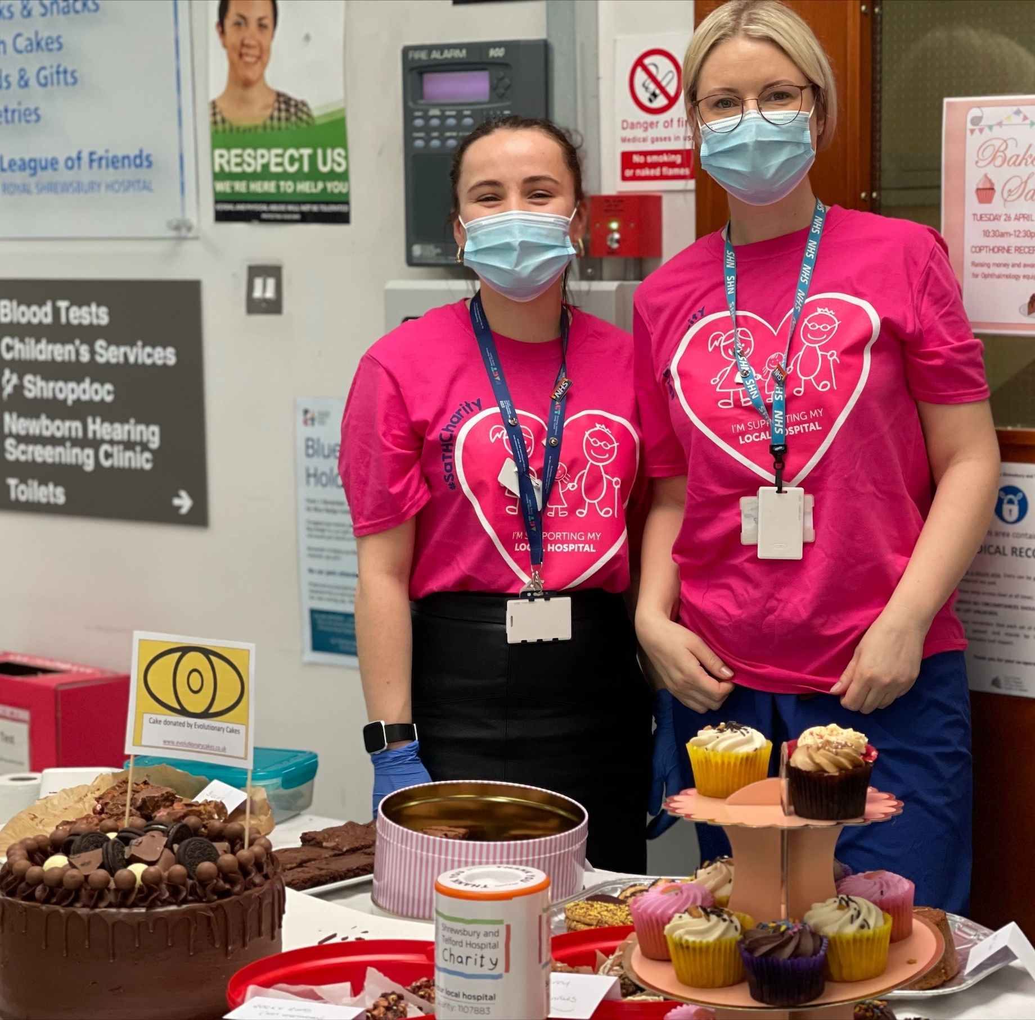
SaTH CHARITY
Nicky Brierly, Cardiology Nurse, raised £248 in a cake sale. This is part of her London Marathon fundraising.
The NHS Big Tea took place on the 5th July and over £700 was raised for SaTH Charity from a cake sale, raffle and supermarket collections
Arleane Hodnett, who is a bank nurse for the Trust and runs a private skincare clinic, held a special raffle to raise money for the SaTH Charity Urology Fund at SaTH after close family member were treated at SaTH. £2100 was raised
Tesco’s (Shrewsbury) are supporting SaTH Charity by having an instore collection point where customers can donate pens, crayons and pencils. Donations will be given to our Children’s Play Teams at both RSH and PRH emergency departments.

Slide 19
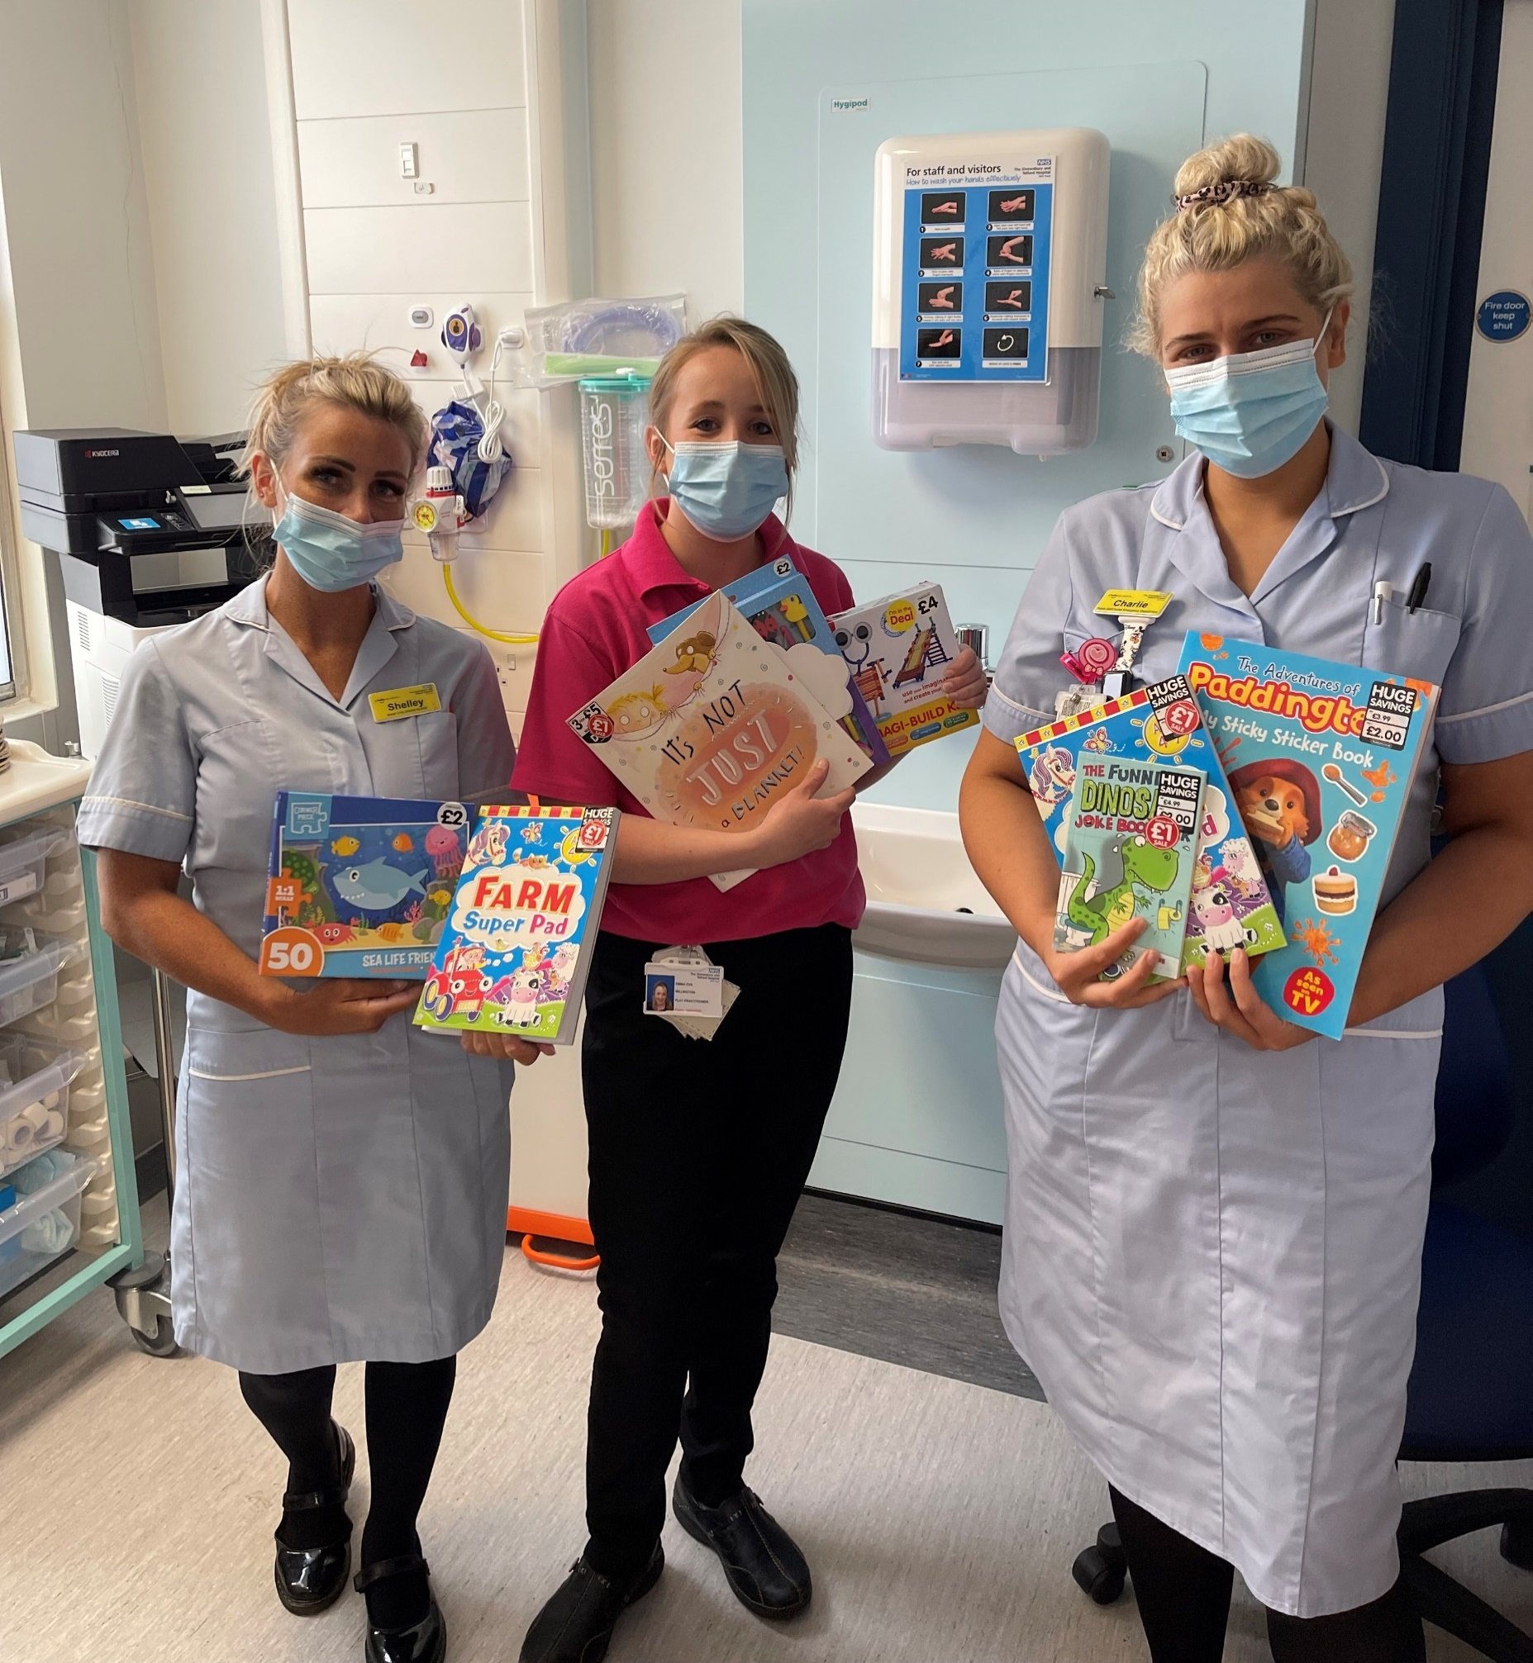
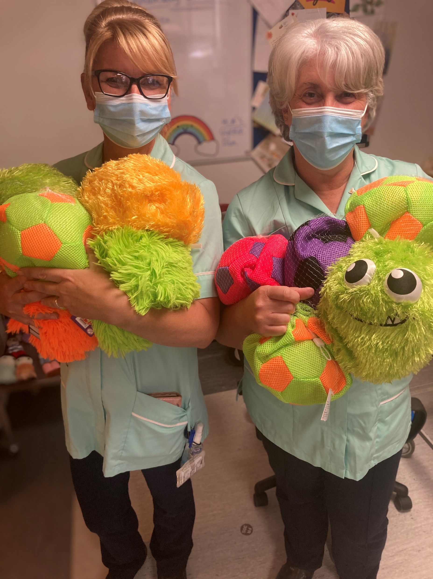
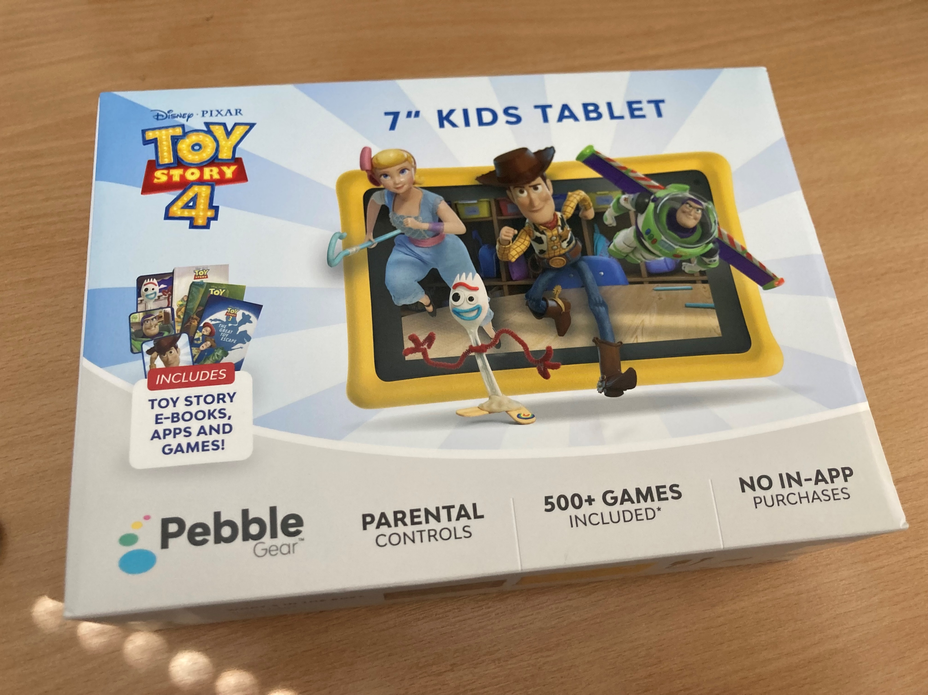
Corporate Partnerships
There have been some extremely successful corporate partnerships in the last quarter
Customers from The Works, Shrewsbury, have been donating items for Children who visit our hospitals. So far 7 large boxes of items have been delivered – these include colouring pens and pencils, activity and reading books, games and many other items.
Good Place Ideas, a company in Newport, donated a Toy Story 4 7” Kids Android Tablet for the Trust to trial. These are returned tablets which have no fault but cannot be listed for resale ‘as new’. The trial has been very well received and a further 10 tablets will be donated to the Trust.

Slide 20
SaTH CHARITY – Expenditure (1)
SaTH Charity has supported ITU with the creation of patients diaries. Being in ITU and not knowing what happen in the days when they were sedated is a scary time for patients. These diaries are designed to document that time and support to patients who can look back over them and fill in blanks from their time in ITU.
A new rest area has been created in Catering at RSH. A small things purchase was made for an attractive wall graphic to make the area more restful for staff.
6 benches were ordered to enhanced outdoor spaces for staff, these will be located in cancer services, A&E, the Queens Mothers Garden and outside Stretton House.

Slide 21
SaTH Charity – Expenditure (2)
The Small Things Big Difference fund continues to support our staff with items for staff rooms and other items that makes their life more comfortable at work.
Funded by the staff lottery and donations that are specifically donated to support staff. Over the past three months there have been many items provided to support staff at SaTH, including:
The Fracture Clinic at PRH bought plants with money they received from the Small Things Fund
We supported Dr Pam Sturgess Healthcare in Art classes
During the heatwave, reminded staff they could ask for a fridge from the small thing funds if they didn’t have access to one. In total 12 fridges were ordered for very grateful staff.
A hard top garden pavilion was put into the ENT courtyard to provide cover during winter months.

Slide 22
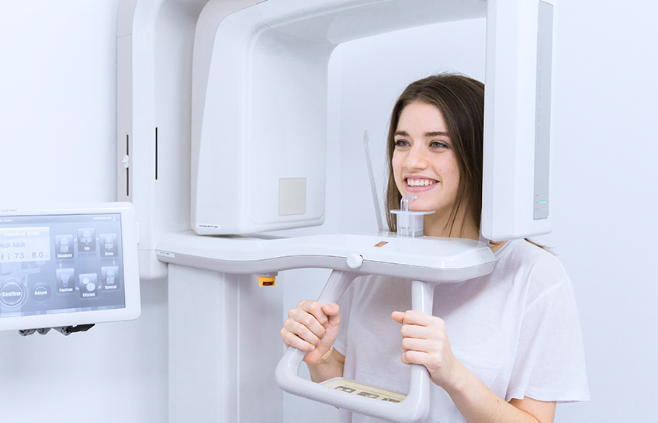
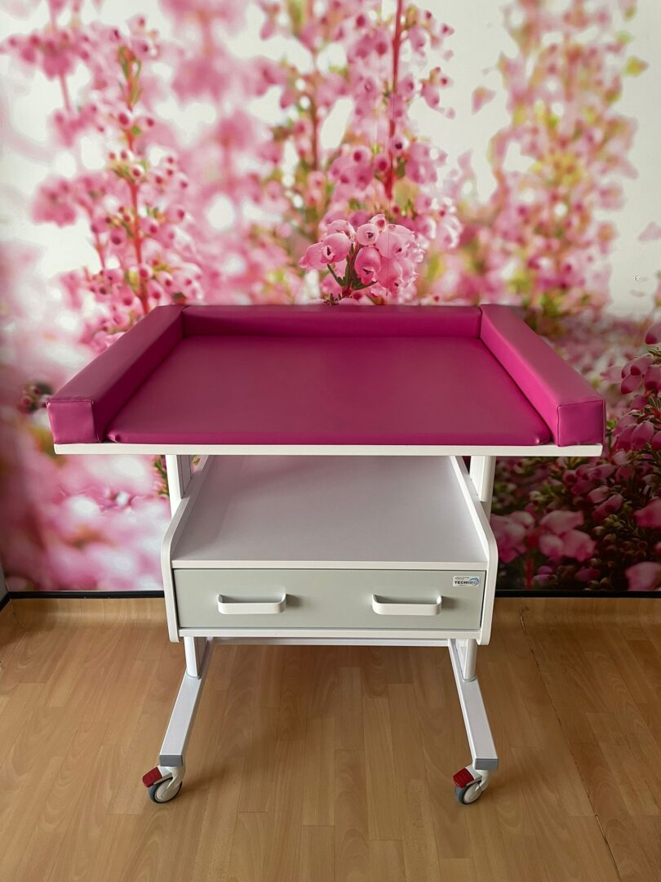
SaTH Charity – Expenditure (3)
In Quarter 2 SaTH Charitable funds supported the following equipment and training. Examples of spending over £1000:
General Fund:
Patient Safety Utilising Fall Mats and Sensor Pads - £1,468
ITU:
14 x Waiting Room Chair Galaxy Visitor Chair - £1,134
R&B Scentific x8 Kango High Chair - £2,496
Swan Fund:
2 x reclining arm chair – £2,676
Breast Cancer Fund:
Vscan Air CL G1 kit - GE Healthcare- £3,490
Sub-Speciality Cancer Fund:
Overchair Table Height Adjustable - Polymer Clean Chair - £2,918
Respiratory Ward:
Nellcor Dura Ear Probes - £1,268
Cone Beam Machine part funded by SATH Charity - £7,277
Maternity General (Consultant Unit):
2x Croyde Baby Assessment Tables and 1 x cot and 1x bed - £7,819
SoundEar Microphone and Software - £1,148

Slide 23
Forward Plan
The Public Assurance Forum to meet on 9th January 2022
Supporting staff with any service changes engagement
A Young People’s Academy and a People’s Academy to start in Q3
Social media campaign to recruit young volunteers starting in September
To continue to support staff wellbeing through SaTH Charity
Volunteer Celebration event on 8th November as part of the staff recognition week
Training sessions with the Divisions in November on successful charitable fund management with Directors and the NED Chair Teresa Boughey attending

Slide 24
Dates for your diary –October/November 2022
Date | Time | Event | Booking
Thursday 13th October | 18:30 – 19:30 | Evening Cascade | Via Eventbrite
Tuesday 18th October | 18:30 – 19:30 | About Health Event (Menopause) | Via Eventbrite
Thursday 3rd November (4 week course) | 10am – 12pm | People’s Academy | Via Eventbrite
Wednesday 9th November | 11:00 – 12:00 | Community Cascade | Via Eventbrite
Thursday 10th November | 18:30 – 19:30 | Evening Cascade | Via Eventbrite
Thursday 24th November | 18:30 – 19:30 | About Health Event (Recovery of Hospital Services after COVID) | Via Eventbrite
Please register for all events online at: https://sathnhs.eventbrite.co.uk/

