Slide 1
Hospitals Transformation Programme: Women and Children’s Focus Group
14 September 2023

Slide 2

Why are we here?
Where are we in the process?
Latest developments
Your feedback
How can you get involved?
Questions
Julia Clarke, Director of Public Participation
Matthew Neal, Director of Hospitals Transformation Programme
Adam Ellis-Morgan Technical Lead for the Hospitals Transformation Programme

Slide 3
Introduction

Slide 4
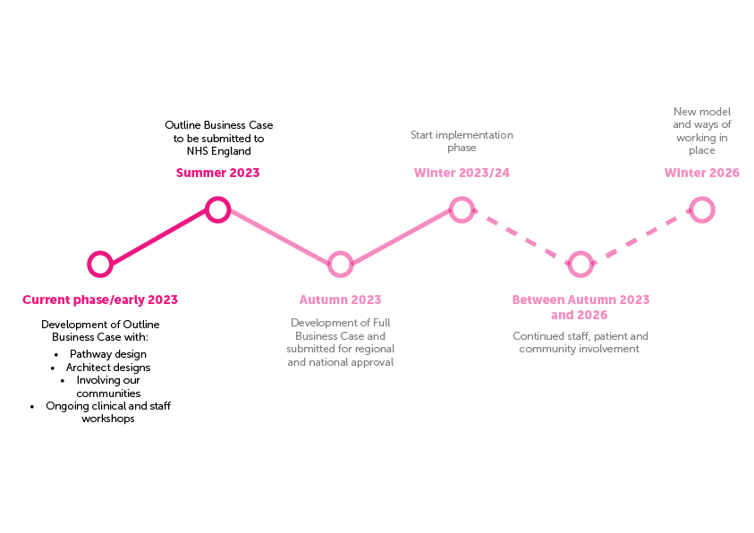
Where are we in the process?
Notes:
Matt.
A quick recap.
Although we’ve been on the journey for some time, there is still a lot of work to do and we submitted the Outline Business Case for national review at the end of last week.
We have been working with our lead clinicians to add further detail to the clinical model. There is still opportunity for people to influence the physical environments and people’s experience of our services.
The process is ongoing and hopefully we’ll soon get the final national approvals to achieve our vision of improved care for everyone.
Four key messages:
1. The investment will improve care for everyone/the services that we provide to all of our communities will be improved.
2. Our plans will deliver two thriving hospital sites.
3. We cannot continue as we are.
4. We must put the available funding to good use.

Slide 5

Where are we in the process?
We’ve worked with our lead clinicians to add further detail into the clinical model to start to design the “flow” of clinical services (how our clinical teams will work and connect to each other).
On track to submit the Outline Business Case during Summer 2023
Seeking planning permission for building works at the Royal Shrewsbury Hospital
Preparations underway to be ready for the implementation phase
Your feedback is continuing to inform the development of our proposals. This involvement will continue and over the next few weeks, months and years there will be many opportunities for people to help us influence the physical environments and people’s experience of our services.

Slide 6
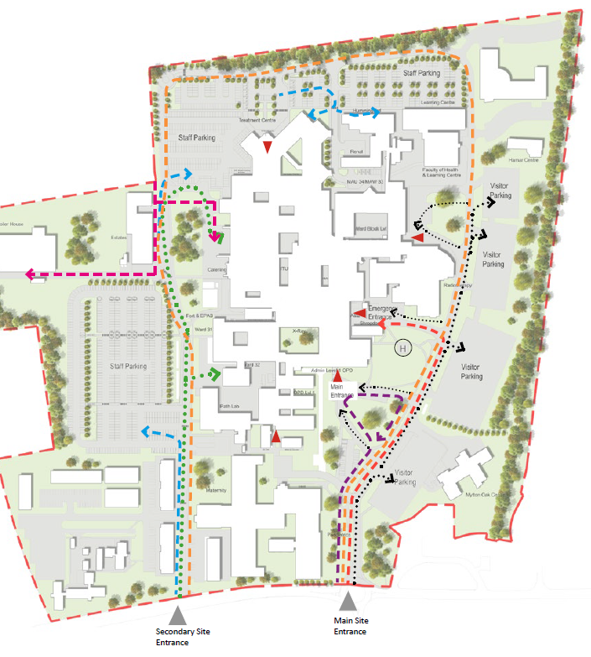
Location of the new build at RSH
Easier to access for patients
Better clinical adjacencies between services
Improved, modern main entrance for patients

Slide 7

Latest developments: approach to planning
We are working with Shropshire Council as part of the planning process for the Royal Shrewsbury Hospital site.
This supports our developing plans to ensure, if approved, we have full implementation by late 2026 and can provide improved care for everyone across Shropshire, Telford & Wrekin and mid Wales.
We are working through the design and planning to ensure our facilities will deliver the clinical model and core outcomes of the Future Fit consultation in the most effective and efficient way within the investment.
We’ll continue to work with staff, patients and communities to inform plans at every step of this improvement journey.

Slide 8
Feedback received so far from engagement
Respondents identified the most important aspect as being reorganisation of the hospital’s parking layout, including a new hospital entrance facing the major public carpark.
Respondents identified the least important aspect as the improvements to the hospital experience with soft landscaping to the exterior, a new entrance leading to a café and modern courtyard spaces.
The vast majority of respondents either like the design of the buildings or like the design of the buildings but have some reservations, a small number of respondents stated that they were unsure as to whether they liked the design of the buildings or not.
There were a number of recurring themes, in both verbal and written feedback, during the Planning events, including:
The most common theme that was around parking.
Many attendees and respondents stated that the existing buildings were dated and need upgrading.
A number of people referenced the narrow entrance road and roundabout off Mytton Oak Road as a concern.
Concerns about the increase noise, particularly from the helipad and ambulances as well as during construction.
A few respondents raised the issue of a lack of public transport between the two hospital sites.

Slide 9
Construction
  Some disruption to users and local residents in respect of noise, dust and vibrations.
  Residents will be consulted on a construction management plan, which will be agreed with the council.
  The development will be carried out in phases whilst maintaining the full operation of the hospital.
An indicative timeline of building works subject to planning permission and other factors:
Site Set Up
Enabling Works
HTP Main Build
Autumn 2023 - Summer 2024
Spring 2024- Late 2026
Late 2023

Slide 10
Transport
Comprehensive review of the transport facilities onsite undertaken.
Increase in overall parking.
The staff car parking provision reorganised.
Vehicle access points into the site will remain unchanged.
Relocated hospital entrance, which will now face the major public car park.
Increase in cycle parking.
We will continue to work with service users, local communities and colleagues as we develop our Travel and Transport plans for both hospitals.

Slide 11
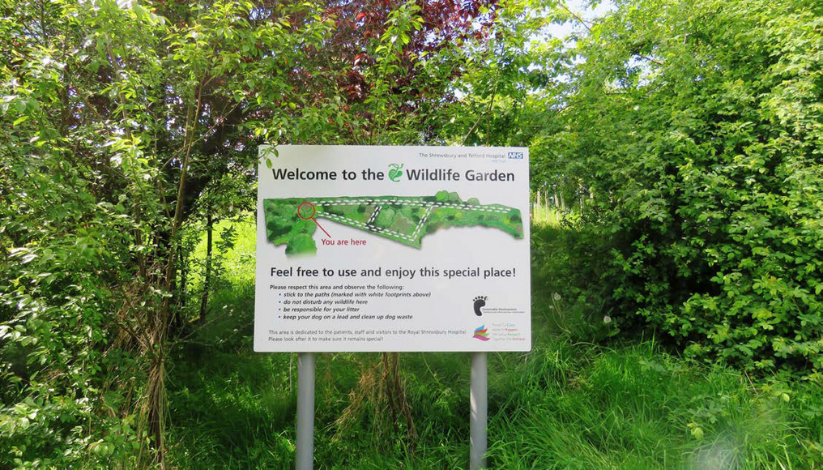
Sustainability
  Aim to achieve BREEAM excellent, using sustainable building solutions such as solar panels.
  The project aims to be Net Zero Ready which means the building will be capable of adapting to future sustainable technologies.
  Proposals include neutral grassland, hedgerow mixed scrub and the introduction of shrub planting around the boundary of the building.

Slide 12
Update from Women and Children’s Division

Slide 13
Action log from previous meeting –
5 June 2023
Agenda Item | Date of Meeting | Action | Lead Officer | Timescale / Deadline | Comment / Feedback from Lead Officer | Action
Part 1 | 05/06/2023 | Kate Ballinger to liaise with focus group member (MA - Focus group member) and Ruth Smith (Lead for Patient Experience) to discuss what the Trust can do to support Children with Learning Disabilities accessing our services. | Kate Ballinger | 30/06/2023 | Introductory email sent 06/06/23 and plans to involve MA in development of alternative video tours of new build with RS. | COMPLETED
Part 1 | 05/06/2023 | Julie Plant to contact questioner (MA - Focus group member) regarding involvement in the current facilities and additionally advise for reassurance, that there is now a Paediatric Mental Health Nurse employed as part of the children's unit which she will also be happy to discuss with MA. | Julie Plant | 30/09/2023 | Contact made by Julie Plant (delayed due to unavoidable circumstances) and meetings have been arranged to discuss further | COMPLETED
Part 1 | 05/06/2023 | The earlier slide which mentioned the digital links, are you working with Wales for the cross boarder digital links? Kate Ballinger to contact the digital team to find out current position. | Kate Ballinger | 31/07/2023 | Information received from Digital team and passed on the HG at Powys Teaching Health Board. | COMPLETED

Slide 14
Action log from previous meeting –
5 June 2023
Part 1 | 05/06/2023 | Julie Plant (Divisional Director of Nursing) to contact focus group members (JS and MA) to discuss the development of a children and young people participation group and also the parent element of the Post-Acute Care Enablement (PACE) team. | Julie Plant | 30/09/2023 | Contact made by Julie Plant (delayed due to unavoidable circumstances) and meetings have been arranged to discuss further | COMPLETED
Part 1 | 05/06/2023 | Kate Ballinger to introduce JS and MA to Ruth Smith (Head of Patient Experience) as one of her big focuses is around children and young people with learning disabilities. | Kate Ballinger | 30/06/2023 | Introductory email sent 06/06/23 and plans to involve MA & JS in development of alternative video tours of new build with RS. | COMPLETED
Part 2 | 05/06/2023 | Travel is coming up quite a bit in the conversations we're having. How do you think we can manage this together? It has been suggested hospital transport, what other solutions do you think there are? | Hannah Morris | 30/09/2023 | Travel and Transport Group arranged for 28th September | COMPLETED
Part 2 | 05/06/2023 | Hannah Morris link with the ICS regarding feedback that Patient Participation Groups would find it useful to have a responsible lead within the ICS for patient groups (as they previously had within the CCG). | Hannah Morris | 31/07/2023 | HM met with Kate Manning. It was agreed that Kate would liaise with the Patient Participation Groups to look at how they link, share information and involve PPG groups | COMPLETED

Slide 15
Women & Children’s Division
HTP Quarterly summary
EHIIA development
1:200 departmental design for Maternity services, Neonatology, Paediatrics and Gynaecology
Room Data Sheet detail
Public engagement during planning permission consultation
Next 3 months
1:50 design and room data sheet collation
Continuation of work programme to deliver the clinical model e.g. pathways, workforce and estate allocation

Slide 16





In continuing the programme, we will need input from across the Divisions to develop detailed plans
The following areas will need significant input from across the Trust through the FBC period
Key work area | Requirement | Key stakeholders (in addition to HTP)
Finalising the detailed designs | Inputting to the detailed designs for all the new areas | Divisions
Developing the operational plans for the new clinical model | Developing the detailed workforce model, recruitment and training plans and change management approach Defining the new pathways and approaches within the new clinical model | Divisions Exec team
Managing key dependencies | Delivering the out of hospital plans – demonstrate the plan, the patient impacts, pathways and timeline Demonstrating delivery of the Trust digital strategy Aligning with wider estates plans | Strategy Digital Estates | Clinical divisions ICS and partners (inc. LCTP)
Contracting for the deal | Putting in place all the contractual arrangements for the full scope of the project Managing the contract, project and cost effectively | Finance Commercial ICS
Preparing for implementation | Demonstrating the governance, plans and resources are all in place to deliver this effectively | Exec team Divisions
Notes:
The first 2 key work areas will require patient involvement.

Slide 17
W&C Services within the new build at RSH
Floor | Service
Ground Floor | UTC and Emergency Department
 | Acute Medicine including Short Stay Ward and SDEC
Level One | Maternity Delivery
 | Neonates
 | Gynaecology (including EPAS)
Level Two | Maternity Inpatients
 | Paediatrics (including paediatric oncology and CAU)
Level Three | Critical Care
 | Oncology and Haematology Inpatients

Slide 18
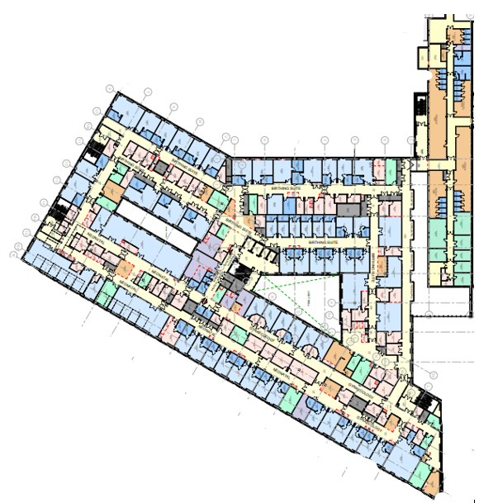
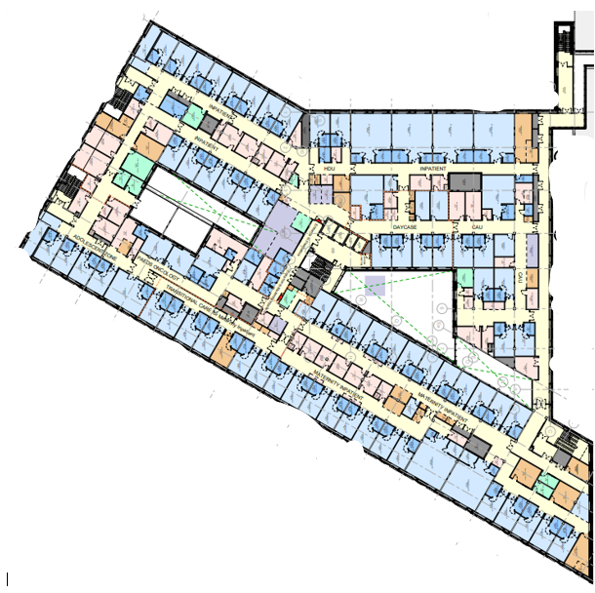


Designs
High level floor plans and artist’s impressions – site location
Level 1
Level 2
Maternity Delivery
Paediatrics
Paediatrics
Neonates
Gynaecology
Maternity In Patients

Slide 19
Update from AHR Architects- Gareth Banks, Regional Director

Slide 20
How can you remain involved?

Slide 21
Focus groups
We are entering an exciting phase for the programme as we design the detailed patient pathways. We are committed to engaging and working closely with our local communities, patients and colleagues to ensure we improve the experience for all the communities we serve.
Travel and Transport MS Teams focus group: 28 September 3pm-5pm
We are also identifying opportunities to involve our wider communities and those directly identified following the EQHIA process.
Our next HTP About Health event will be held on MS Teams on 7 November at 6.30pm
If you would like us to attend an existing meeting or join you at an event, please email: sath.engagement@nhs.net

Slide 22
Get involved
There will be a range of ways to get involved over the next few years
You can help us develop these plans in the best way for the future of local healthcare services
Talk to your colleagues, friends and family about the programme
Let us know your thoughts on our plans
Take part in future sessions and workshops – help us to design services that better meet local needs
We need to understand your perspectives
We want to ensure that anyone who is interested can get involved in some way.
If you would like us to attend a meeting to update your group/organisation or to register for a focus group, email us on sath.engagement@nhs.net
Keep looking at our website for more information: www.sath.nhs.uk/about-us/hospitals-transformation-programme/
If you want to hear more about what’s happening at our hospitals and how to get involved, email sath.engagement@nhs.net
Notes:
Julia

Slide 23
Questions
Notes:
Julia to ask:
There is still some vocal opposition to the plans, what would you say to people concerned about changing services?
Travel and Transport is a key topic but what about accessibility in the building designs? (disabled access/drop off points). Is this an opportunity to take people’s feedback on board?
Ambulance and ED pressures are widely reported, how will this make things better?
Remind us again why this can’t be one new, big hospital site?
Isn’t this project really being led by the money?
How confident are you around the plans going forward?
How will people know what’s happening? (Julia response around involvement opportunities and comms)
We all know that there has been a significant amount of inflation in the construction industry. How confident are you that we are going to deliver the plans in the current funding envelope?

Slide 24
Thank you for joining us…
We will upload the presentation and Q&As on our website: www.sath.nhs.uk
If you sign up to become a community member sath.engagement@nhs.net we will keep you updated on how you can get involved and updated on the programme through our monthly update.
Any further questions, please email: sath.improvinghospitals@nhs.net

Slide 25
Thank you

