Slide 1
Armed Forces Community Recruitment Guide

Slide 2
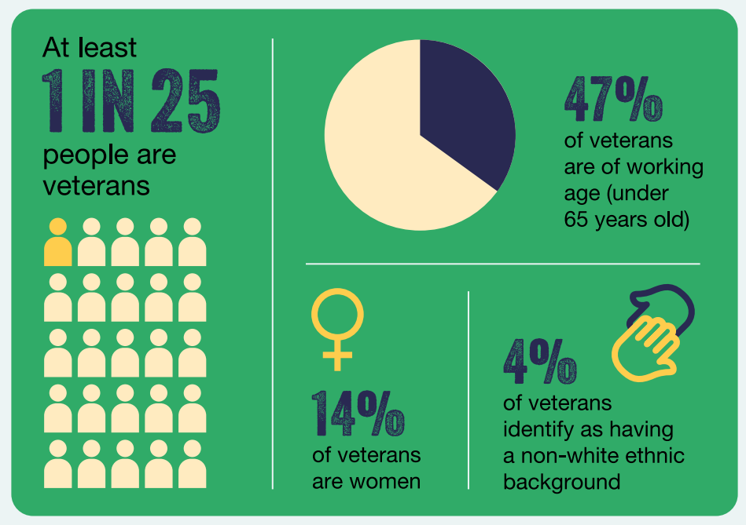
Manager’s Guidance

Slide 3
Advertising
All jobs are advertised via our NHS Jobs “trac” system, and we pledge the following commitment on all adverts:
Armed Forces Recruitment: The trust is an accredited employer and positively recruits those that have served in the Armed Forces. If a candidate during the recruitment process has ticked and declared they are a veteran, as an employer we are required to guarantee an interview if they have met the minimum essential criteria. As a trust we have an Armed Forces Policy to support managers and employees. Other policies linked to this are Annual Leave Policy, Roster Policy, Flexible Working Policy and Special Leave Policy.
Logos in relation to the positive recruitment of armed forces are placed on adverts as
well as the Veteran aware tick. We have a general advert on CTP and FFJ to direct any interested candidates to our main website to view our full list of live jobs.

Slide 4
Advertising with our partners
We are signed up with Step Into Health (SIH) , their programme:
Connects candidates from across the Armed Forces community with employers and new opportunities in the NHS. Step into Health provides support and guidance for NHS organisations to review and enhance recruitment practices, so they are able to attract members of the Armed Forces community, benefit from the transferable skills and values they bring to the workforce and showcase the NHS as the employer of choice.
You can find out more by clicking on: Step into Health | NHS Employers
Our SiH pledge is to ensure we are:
Reviewing recruitment practices and removing any barriers to recruiting members of the Armed Forces community.
Sharing dedicated Step into Health contact details.
Building a relationship with the Career Transition Partnership (CTP).
Using the Step into Health branding to promote consistent messages about the programme.
Using the Step into Health candidate system to record interactions with potential candidates and to refer between NHS organisations as required.
We also advertise on Forces Families Jobs website, please click on: Forces Families Jobs - Forces Families Jobs) for more information.

Slide 5
Benefits of Recruiting Military Community
1. Over half (53%) of employer's report that the veterans they employ are promoted more quickly in comparison to their colleagues
2. Another benefit of hiring veterans is the 12 months of National Insurance contribution holiday available to those employing a veteran in their first civilian position after service.
3. Almost all (92%) working age veterans have qualifications and are more likely to have gained these qualifications through work (60%) compared to non-veterans (43%).
4. When you hire veterans, you have immediate access to someone with training, qualifications and valuable experience all gained during their time in service.
5. In the UK, the majority of employers asked (66%) are interested in having, or having more, UK Armed Forces ex-service personnel in their organisation.
6. Those already employing veterans in their workforce reported that they can readily identify proficiency in key skills and attributes which can be delivered at pace and high value in today’s civilian workspaces including:
• strong work ethic
• problem solving
• leadership
• communication skills
• dedication and analytical skills
• able to work in highly pressured situations
• able to work in hostile environments and high-pressured situations
• able to deescalate and resolve conflict
• able to work independently

Slide 6
Shortlisting – must do’s
The recruiting manager must have attended the Trust’s Safer Recruitment training accessible via: SaTH Intranet – Recruitment and must ensure that throughout the recruitment and selection process no discriminatory practices occur.
Armed Forces candidates who have declared a disability or specific learning difficulties are required to be shortlisted if they meet the essential criteria. Those with a disability will be asked to specify what adjustments they will require prior to attending an interview/ assessment.
If they do meet the minimum criteria, then they must be offered an interview.

Slide 7
Shortlisting Tips
Forces Employment Charity Provides employers with support in recruiting, retaining, promoting and supporting military candidates through the application process. With access to over 20,000 ex-Forces personnel every year, they help employers recruit experienced individuals who bring a wide-ranging list of transferable skills acquired during their time in the Armed Forces. You can find out more online at: www.forcesemployment.org.uk.
Veterans will often focus on practical points about their time in service and talk about what ‘we’ rather than ‘I’ did to accomplish goals and overcome barriers. This doesn’t always tell you as an employer what you need to know.
Providing opportunities during application and interview for veterans to talk openly about their strengths and skills and how these are relevant to you as the employer can help to translate what they have to offer in a way that makes sense for your business.
Fully explained role descriptions which avoid industry specific phrases and acronyms have the best chance of being understood by veterans.

Slide 8
Prior to and Interview Tips
Ask the candidate if they have any specific requirements for the interview to ensure they are comfortable and able to perform the interview.
In the interview with veterans talk openly about their strengths and skills and how these are relevant to you as the employer can help to translate what they have to offer in a way that makes sense for your business.
Value-based interviews should be performed, for more information on this please click here: Values-Based Interview Procedure.pdf (sath.nhs.uk)

Slide 9
Appointment must do’s
If the candidate is successful at interview, you will be required to log this on ESR (can only do in HR Administrator) when completing the usual pre-employment checks following the process below:
Search the candidate on ESR Select ‘others’
Select ‘supplementary roles’
Select next free box and under Job Group add ‘NHS supplementary role’
Under role select ‘Armed Forces Veteran’ and add the start date as their first day in their role.
This will then log the individual as a member of the Armed Forces (AF’s) community.
If unsuccessful at interview they must be provided with personalised feedback by the interviewing manager.

Slide 10
Appointment/Commencement
When appointing the candidate please provide feedback of the interview and be clear on the expectations of them prior to their start date. Ensure you provide them with the Armed Forces intranet link: SaTH Intranet - Armed Forces which they mind find useful.
Please ensure they are booked onto the induction training prior to commence date if possible, ensuring to advise them of what to expect and what is expected of them.
There are a list of our Veteran Aware (VA) champions who are available to provide mentorship to your appointed Armed Forces candidate, please click here for the list of champions.
Managers are encouraged to provide their own introduction pack for their area and a two-week induction timetable to ensure the transition period is clear and supportive.

Slide 11
Retention Guidance
Employers who benefit the most from the value that veterans have to offer provide opportunities for continued progression and development, and create a culture of inclusion and belonging for those who join their business
The steps outlined opposite will help you to retain the talent of the veterans and members of the Armed Forces community that you have recruited into your workforce and will in turn help them to achieve rewarding and fulfilling careers within your business.

Slide 12
Retention Tips 1
Talent development: Dedicated talent development programmes have a demonstrated track record of success in improving capability and performance, and increased likelihood of retention. This often focuses on activity after the recruitment stage such as learning & development and progression. This can help to bring out the best in your candidate, unlocking existing potential as well as introducing new skills and expertise. This can help with retention within your workforce, as it provides opportunities for career advancement leading to an increased sense of fulfilment and achievement for those working within your company.
Mentoring and coaching: This provides the opportunity for someone who is newer to your workforce the opportunity to get to know, trust and learn from the experience of someone who has already been through it. This can help with navigating the world of civilian employment, identify opportunities for progression or promotion and help them to understand and navigate their career path with you as an employer. Many veterans choose to become mentors to other veterans and members of the Armed Forces community, but neither the mentor or mentee need to have served time within the Armed Forces to be an effective support partner to the other. Our Veteran Aware Champions (click here) offer mentoring and/or coaching services.

Slide 13
Retention Tips 2
Networks: There can be similarities but also significant differences between a career in service and a civilian career. An internal source of support in your organisation such as a peer network or employee resource group can help veterans to make their adjustment from service to civilian culture workplaces as smooth and streamlined as possible. The Champions group will be able to offer this support. Please also see the VA Staff pathway (click here).
Line Manager capability: Veterans are well suited for positions of management and leadership, regardless of rank during their time of service. This is because the ability to lead and work well with others is instilled within veterans during their time of service and can translate particularly powerfully when applied to a civilian setting. You can make the most of the value veterans have to offer by offering opportunities to further develop and utilise their leadership and management capabilities. The VA Staff Pathway also includes training for non-military colleagues that you may find supportive.
Internal awareness: Working with other managers and leaders to raise awareness and develop an understanding of the added benefits that veterans can bring to your team can help to further embed all of the practices detailed throughout this guide. By pro-actively promoting this throughout your department, you can make sure that the benefits are not limited to only one area. (SaTH Intranet - Armed Forces).

Slide 14
Applicants Guidance

Slide 15
Application stage
Our jobs are added to a system called “trac” which uploads our jobs to the NHS Jobs webpage (NHS Jobs) once it's been approved. We have a general advert on CTP (Career Transition Partnership) and Forces Families (Forces Families Jobs - Forces Families Jobs), to direct any interested candidates to our main website to view our full list of live jobs. Our organisation is also signed up to the SiH Pledge (Step into Health | NHS Employers). When selecting “apply for this job”, the system will take you to a form to complete as opposed to a CV request. The form prompts you to include whether you are from the Armed Forces Community as indicated below:

Slide 16
Application stage cont.
It is important you complete this section as this informs the shortlisting manager who will ensure they shortlist in conjunction with the guaranteed interview pledge offer. In order to meet this, candidates are required to meet the essential criteria of the role.
The application form has a section called additional information where the candidate it required to detail how they meet the criteria for the post. Within this section you are encouraged to elaborate how you meet the jobs person specification which can be downloaded from the advert prior to clicking apply for job.
Please be note that you can discuss the job role prior to applying, by contacting the named point of contact on the job advert.

Slide 17
Shortlisting stage
Managers are required to shortlist the job within 5 days of closure, but delays may be experienced.
Once the manager has completed shortlisting on Trac, you will be notified via email if you were successful for interview or not.
Unfortunately, managers are not able to provide feedback, to those who are not shortlisted, however feedback can be requested from the named individual on the job advert if required.

Slide 18
Interview stage
Interviews can be a daunting experience, so we have attempted to mitigate some anxieties by providing the following tips:
There is an option on Trac to declare if you require any adjustments for your interview. If something is declared, Recruitment or the appointing manager will be in touch to discuss or otherwise the reasonable adjustments would be accommodated.
Ensure you arrive at least 15 minutes prior to your interview time (if the interview is face to face that is)
Research the hospital values and objectives as you may be asked questions on them
Dress code smart
Prepare some questions of your own
Recruitment will provide a guide on Values Based Questions when the interviews are booked
Fully read the job description and specification, as the questions will be based on them
Prepare a range of examples from your own experiences, to highlight how you meet the skills and competences of the role
Be prepared for jargon that you may never have experienced, but don’t worry its ok to request further explanation.
We have prepared a Values Based interview support pack which can be accessed via click here

Slide 19
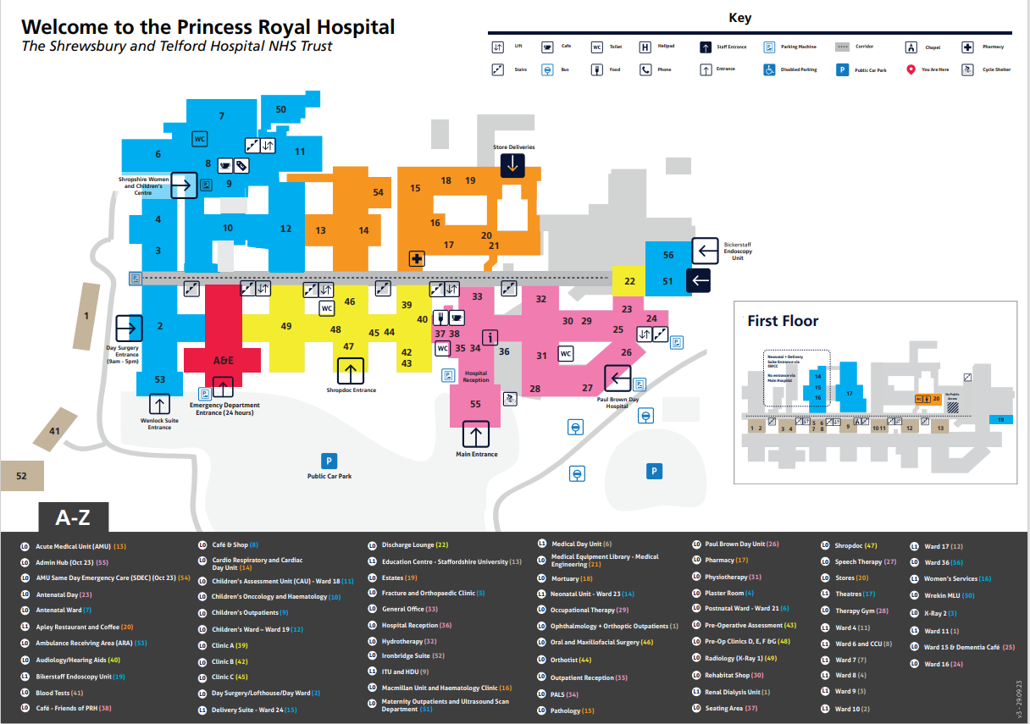
Site Maps

Slide 20
Site Maps cont.

Slide 21
Post Interview
The recruiting manager would normally specify at the interview when you are likely to hear an outcome.
They will provide feedback as to whether you are successful or not.
Please ask questions if required.

Slide 22
Commencement of Employment

Slide 23
Support in your new role
Please scan this code to access the Trust’s Health and Wellbeing offer (Please note this is only accessible when commence work).
Our Armed Forces webpage offers a plethora of materials and key contacts to support your career transition. We have a long list of Veteran Aware champions on the page who will be able to support your transition and provide mentorship and coaching where required. The page can be accessed via SaTH Intranet - Armed Forces
You will be booked onto the Trust Induction and any other training required by the Corporate Education team.
You will also receive a local induction within the department.

Slide 24
Common Acronyms
MEO – Medical Examiner Office
MHA – Mental Health Act
MFFD – Medically Fit For Discharge
MTO – Medical Technical Officer
NEWS – National Early Warning Score
NHSBT – NHS Blood and Transplant
NMFFD – Not Medically Fit For Discharge
OOH - Out Of Hours
OT – Occupational Therapist
PA – Physician Associate and Personal Assistant
PCN – Primary Care Network
PRH – Princess Royal Hospital
PTL – Patient Treatment List
ReSPECT – Recommended Summary Plan for emergency care and treatment
Royal Shrewsbury Hospital
RTL –Referral Tracking List
RTT – Referral to treatment time
SaTH – Shrewsbury and Telford Hospital
Sitrep – Situation Report
SOP – Standard Operating Procedure
SDEC – Same Day Emergency Care
WLI –Waiting List Initiative
For more NHS jargon please visit: NHS England » Understanding NHS jargon
AAU – Acute Assessment Unit
AEC – Ambulatory Emergency Care
ACP –Advanced Care Practitioner
ACU – Ambulatory Care Unit
AHP –Allied Healthcare Professional
BAF – Board Assurance Framework
BC – Business Case
CRB – Criminal Records Bureau
CSW – Clinical Support Worker
DNA –Did Not Attend
EPR – Electronic Patient Record
EPMA – Electronic Prescribing and Medicines administration
FLT- Family Liaison Team
FTE – Full Time Equivalent
HWB –Health and Wellbeing Board
HEE – Health Education England
ICB – Integrate Care Board
ICC- Integrated Care Community
ICP Integrated Care Partnership
ICS – Integrated Care System
LMS – Learning Management System
MCA – Mental Capacity Act

