Slide 1
HAEMATOLOGY GP Pathway Guides

Slide 2
Contents
Lymphadenopathy
Splenomegaly
Lymphocytosis
Lymphopenia
Neutropenia
Neutrophilia
Eosinophilia
Polycythaemia
Thrombocytosis
Thrombocytopenia
Paraprotein
Microcytic anaemia
Normocytic Anaemia
Macrocytosis
Pancytopenia
Hyperferrintinaemia

Slide 3
Lymphadenopathy
B Symptoms
Weight loss >10% over 6 months
Drenching sweats,
Unexplained fever >38°C
Lymphadenopathy
Lymphadenopathy- look for causes
Lymphadenopathy associated with:
B symptoms
Liver and spleen enlargement
Rapidly increasing in size
Generalised lymphadenopathy
Cytopenias
Localised unexplained adenopathy
OR
Concerns of metastatic node
Appropriate referral to surgical team or ENT for biopsy/ radiological biopsy (US or CT guidance)
Refer to Haematology on urgent (suspected cancer) pathway
Causes:
Acute and chronic bacterial infections
Syphilis
Auto immune conditions
Malignancy (haematological/ metastatic)
Viral infections (including HIV, EBV, CMV)

Slide 4
Splenomegaly
B symptoms
weight loss >10% over 6 months
drenching sweats,
unexplained fever >38°C
Splenomegaly
NB: Spleen increases with height. On average increases in length by 0.2 cm for every inch > 6ft
Spleen >13cm
B symptoms
Cytopenias
Paraprotein
Lymphadenopathy
high haemoglobin or increased platelet count
Evidence of haemolysis
High WBC
Leuco-erythroblastic blood film
If Criteria not met for urgent referral look for causes
If no obvious cause refer to Haematology
Refer to Haematology on urgent (suspected cancer) pathway
Causes
Infections – Viral (HIV, EBV, CMV) and parasitic
Alcohol
Liver disease
Cardiac failure
Autoimmune
Lymphoproliferative disorders
Myeloproliferative disorders (such as CML or myeloproliferative disorders)
Haemolysis

Slide 5
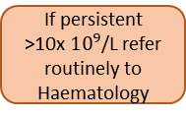

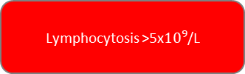
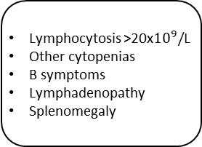
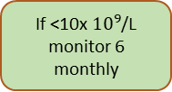
Lymphocytosis
B Symptoms
Weight loss >10% over 6 months
Drenching sweats,
Unexplained fever >38°C
Lymphocytosis
Lymphocytosis >5x${10}^{9}$/L
Lymphocytosis >20x${10}^{9}/$L
Other cytopenias
B symptoms
Lymphadenopathy
Splenomegaly
Lymphocytosis 5-20x${10}^{9}$/L
Repeat FBC in 2 months and
look for causes
Refer urgently (suspected cancer) to haematology
If <10x ${10}^{9}$/L
monitor 6
monthly
If persistent
>10x ${10}^{9}$/L refer
routinely to
Haematology
Causes:
Smoking
Viral infections especially Glandular fever
Lymphoproliferative disorders (such as CLL)
Bacterial infections
Post-splenectomy
Rheumatoid arthritis

Slide 6
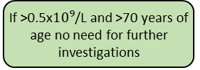
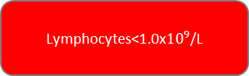
Lymphopenia
Red Flag signs
Weight loss
Fevers
Drenching night sweats
Recurrent infections
Lymphopenia
Lymphocytes<1.0x${10}^{9}$/L
Lymphocytes <1 and red flag symptoms examine for lymph nodes and if present refer to ‘Lymphocytosis’ pathway
If >0.5x${10}^{9}$/L and >70 years of age no need for further investigations
If no red flag symptoms repeat FBC in 3 months and look for causes
Refer to haematology only if suspicious of lymphoma
Causes:
Elderly patients
Infections including HIV, hepatitis B and C
Excess alcohol
Malnutrition
Medications-steroids, chemotherapy, antiepileptics, antidepressants
Systemic immune conditions
Systemic illness(renal, cardiac, liver failure, malignancy)
Lymphoma

Slide 7

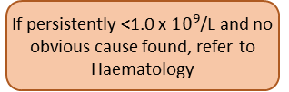

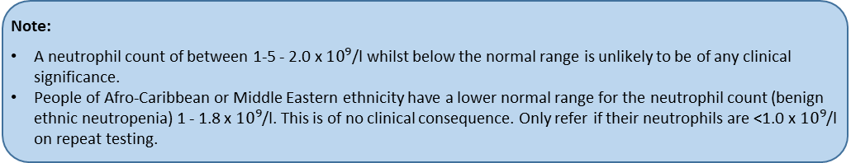



Neutropenia
Causes To Consider
Drugs
Myeloma
B12/folate deficiency
Autoimmune
Any viral infection including HIV/Hepatitis B/C
Neutropenia
Neutrophil Count <1.8 x ${10}^{9}$/L
Neutrophil Count <0.5 x ${10}^{9}$/L
Neutrophil Count 0.5 - 1 x ${10}^{9}$/L
Neutrophil Count >1 x ${10}^{9}$/L
Patient well with no fever
Evidence of sepsis
Repeat FBC in 1 week and look for causes
Repeat FBC in 6 weeks and look for causes
Consider repeat in 1 week
If no obvious cause (see box above) refer urgently to Haematology
Admit to hospital for management of Neutropenic sepsis
If persistently <1.0 x ${10}^{9}$/L and no obvious cause found, refer to Haematology
If between 1.0-1.8x ${10}^{9}$/L then monitor annually.
Note:
A neutrophil count of between 1-5 - 2.0 x ${10}^{9}$/l whilst below the normal range is unlikely to be of any clinical significance.
People of Afro-Caribbean or Middle Eastern ethnicity have a lower normal range for the neutrophil count (benign ethnic neutropenia) 1 - 1.8 x ${10}^{9}$/l. This is of no clinical consequence. Only refer if their neutrophils are <1.0 x ${10}^{9}$/l on repeat testing.

Slide 8
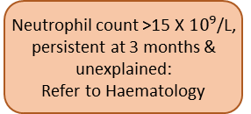
Neutrophilia
Neutrophilia
Neutrophil count elevated
If chronic myeloid leukaemia is suspected you will be contacted by a haematologist to organise urgent admission or outpatient review and further investigations as indicated
Assess if there is a clear cause for this:
Infection
Inflammation
Steroids
Pregnancy
Smoking
Underlying neoplasia
If cause unclear check:
Blood Film, if not done
ESR
CRP
U&E
LFT
ANA & Rheumatoid Factor
PSA etc. led by history
Neutrophil count >15 X ${10}^{9}$/L, persistent at 3 months & unexplained:
Refer to Haematology

Slide 9



Eosinophilia
Red Flag Signs
If Eosinophil count>2.5 look for signs of organ damage and consider urgent admission:
Venous Thromboembolism
Congestive Heart Failure
Gastrointestinal
Neurological
Pulmonary
Eosinophilia
Eosinophils >0.5x${10}^{9}$/L
Repeat FBC in 2 weeks and look for causes if > 1.5 (such as IgE level, Autoimmune Screen, Stool Cultures)
No cause found
If secondary cause found, treat as appropriate
If <5.0 x ${10}^{9}$/L and persistent for 3 months
If >5.0 x ${10}^{9}$/L
and only if no other cause
Refer routinely to Haematology
Refer urgently to Haematology
Causes
Asthma / atopic dermatitis / acute urticarial
Infections: especially those due to parasites (most commonly helminthes - hookworm, schistosomiasis - but also giardiasis or other protozoal infections and strongyloides)
Drugs (penicillins, carbamazepine, sulphonamides are common but any drug is a possible cause)
Connective tissue disease (rheumatoid arthritis, polyarteritis nodosa, Wegener's granulomatosis)
Solid malignancy (breast, renal and lung cancer)
Respiratory disease (Churg-Strauss syndrome, bronchiectasis, cystic fibrosis)
Myeloproliferative disorders

Slide 10
Polycythaemia
Polycythaemia
High haematocrit (Hct) >0.51 in men, >0.48 in women
Hct Male > 0.600, Female > 0.560 in the absence of congenital cyanotic heart disease
Recent arterial or venous thromboembolism
Neurological symptoms
Visual Loss
Abnormal bleeding
Does not meet criteria for urgent referral- repeat in 2 months and consider causes (see below)
If no obvious secondary cause and persistent on 2 samples
1-2 months apart, refer to Haematology routinely.
Refer to urgently to Haematology
Causes
Drugs – diuretics, testosterone, anabolic steroids, SGLT2 inhibitors
Lifestyle choices -smoking, alcohol
Hypoxia

Slide 11
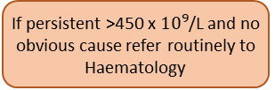
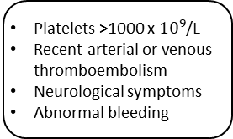


Thrombocytosis
Thrombocytosis
Platelets >450x${10}^{9}$/L
Platelets >1000 x ${10}^{9}$/L
Recent arterial or venous thromboembolism
Neurological symptoms
Abnormal bleeding
Platelets >450 x ${10}^{9}$/L
Repeat FBC in 6 weeks and look for causes
Refer urgently
to Haematology
If persistent >450 x ${10}^{9}$/L and no obvious cause refer routinely to Haematology
Causes
Iron Deficiency Anaemia
Malignancies especially the LEGO cancers (lung, endometrium, gastric and oesophageal)
Inflammation
Infection
Post-Splenectony and Hyposplenism (e.g. Coeliac Disease)
Myeloproliferative Disorders
Post-Operatively
*Note: Persistent thrombocytosis has been shown in large scale studies to be a precursor feature of malignancy. Therefore, if no immediate cause is found, close clinical follow-up is advised.

Slide 12
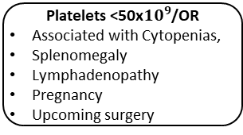
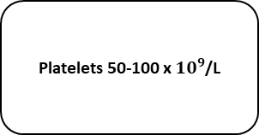
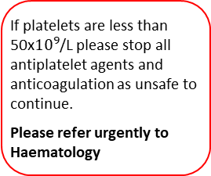

Thrombocytopenia
If platelets are less than 50x${10}^{9}$/L please stop all antiplatelet agents and anticoagulation as unsafe to continue.
Please refer urgently to Haematology
Thrombocytopenia
Platelets<150x${10}^{9}$/L
Platelets <20
Active Bleeding
Blasts In Film
Fragments In Film
Altered Conscious Level Or Confusion
Platelets <50x${10}^{9}$/OR
Associated with Cytopenias,
Splenomegaly
Lymphadenopathy
Pregnancy
Upcoming surgery
Platelets 50-100 x ${10}^{9}$/L
D/W on call Haematology to arrange urgent direct assessment
Repeat FBC in 1 week
Repeat FBC in 4 weeks and look for causes
If persistent refer urgently to Haematology
If persistent and unexplained refer to Haematology routinely
Causes
Spurious result from clumping – please look at blood film report and repeat ‘FBC for platelet clumping in citrate’ using citrated (blue top) bottle
Immune thrombocytopenic purpura (ITP)
Alcohol
Liver dysfunction
Medications
B12/folate deficiency
HIV/Hepatitis B/C
Bone marrow failure/infiltration

Slide 13
Paraprotein
End Organ Damage:
Hypercalcaemia
Unexplained renal impairment
Anaemia or other cytopenias
Bone pain or pathological fracture
Paraprotein on Serum Protein Electrophoresis
Paraprotein <30
SFLC ratio <8 or >0.1
No Immunoparesis
No End Organ Damage
Any of following:
Paraprotein >30
SFLC ratio >8 or < 0.1
Immunoparesis (low IgM/G/A)
End Organ Damage
Lymphadenopathy
Splenomegaly
Low Risk MGUS
IgG <15
IgM and IgA <10
SFLC ratio <8 or >0.1
No Organ Damage
High Risk MGUS
IgG>15
IgM and Ig A>10
Urgent (suspected cancer) referral to Haematology - ? Myeloma/LPD
Non-urgent referral to Haematology
Urgent referral to Haematology
Note:
If there are concerns regarding the interpretation of paraprotein or Serum Free Light Chain results please discuss with the Haematology team.
*Note: Guideline intended to aid patient discussion and risk stratification on finding a paraprotein.
Further investigations, patient education and ongoing monitoring will occur through haematology following review in haematology OPD

Slide 14
Microcytic Anaemia
Microcytic Anaemia
Hb <120g/L Woman
Hb<130g/L Man
AND
MCV <80
Rpt FBC, ferritin
Ferritin <30mcg/L
Or <50mcg/L with Iron Sats <20%
?h/o menorrhagia, bowel symptoms, bleeding
Is a thalassaemia/ Hb variant likely (ethnic origin)?
Ferritin >50mcg/L
Commence oral iron replacement
Yes
Haemoglobinopathy testing advised
Possible Anaemia of chronic disease / inflammation
If cause unknown
If cause known
Hb abnormality found
No Hb abnormality found
Refer to Haematology or through advice and guidance if Hb <100g/L no evidence of chronic disease/ inflammation
Check patient diet, TTG antibody, consider referral to Gastroenterology/ Gynaecology.
Patients with IDA DO NOT need to be referred to Haematology unless intolerant of oral iron
Treat underlying cause
Refer to Haematology
Possible alpha thalassaemia. If additional concern, discuss through advice and guidance

Slide 15
Normocytic or Macrocytic Anaemia
Hb <120g/L Woman
Hb<130g/L Man
AND
MCV >80
Check:
FBC
Blood Film if not done
UE/LFT
TFT
Vit B12
Folate
Ferritin
Iron Saturations
Reticulocyte count
Serum Immunoglobulins
Serum Free Light Chains
All tests normal or reticulocytes low or picture unclear
Paraprotein detected
Deranged renal function
Elevated reticulocyte count
Thyroid function abnormal
Ferritin <50mcg/L, low Vit B12 or Folate
Advice and guidance if if Hb < 100 and not anaemia of chronic inflammation
? MDS
Refer to ‘Paraprotein’ guideline
Suggest referral to Renal team
Look for evidence of bleeding or haemolysis * and refer to appropriate department
Treat thyroid dysfunction and repeat testing 4-6 weeks
Suggest replace deficiency and assess for underlying cause
*Note: Laboratory markers of possible haemolysis include raised bilirubin, raised reticulocytes and raised LDH.
Discuss with on-call haematologist/A&G if suspicious of haemolysis

Slide 16
Macrocytosis
Macrocytosis
With/without anaemia
Check
Alcohol history
Medication (e.g.methotrexate, metformin, some anticonvulsants, hydroxycarbamide, antiretroviral drugs etc.)
Blood Film
Vit B12 and folate
Reticulocyte count/LDH
LFT
TFT
Serum immunoglobulins
Serum Free Light Chains
Family history
Notes
*A high MCV can be a normal physiological finding in pregnancy
High Mean Cell Volume (MCV)*
Repeat FBC to ensure not spurious (e.g. delayed transport/ overheating etc.)
MCV remains raised
If Vit B12/folate deficient and Hb <80g/L or other cytopenias
Consider referral to Haematology if:
No secondary cause and MCV>105fL if other cytopenias or>110fL in the absence of other cytopenias
No history of liver disease
Dysplasia on blood film
Paraprotein detected
Repeat FBC with reticulocyte count 5-7 days after starting replacement therapy to assess response.
The reticulocyte count should increase on treatment.
If no improvement in Hb after 2 weeks, refer to Haematology
*Note: Cytopenia due to haematinic deficiency can take 8-12 weeks to fully resolve once treated

Slide 17
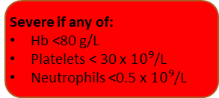
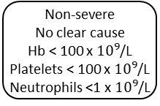
Pancytopenia
Pancytopenia
Clinical assessment and assessment of severity
Severe if any of:
Hb <80 g/L
Platelets < 30 x ${10}^{9}$/L
Neutrophils <0.5 x ${10}^{9}$/L
Consider reversible causes:
Drugs e.g.methotrexate; chemotherapy; carbimazole, clozapine
Haematinic deficiency
Check:
Vit B12/folate
Reticulocyte count
U&E/LFT
Bone profile
Request blood film if not already available
Immunoglobulins and serum free light chains
Clear cause
Non-severe
No clear cause
Hb < 100 x ${10}^{9}$/L
Platelets < 100 x ${10}^{9}$/L
Neutrophils <1 x ${10}^{9}$/L
Severe features present
but clinically stable
Blood film shows concerning features
E.g. evidence of:
DIC
Blasts
Leucoerythroblastic features
Unwell/ febrile/ other clinical concerns
Treat underlying cause and monitor to ensure resolves
Routine referral to general Haematology clinic
? possible reversible cause
Discuss with on-call Haematologist
Consider admission
Follow advice from blood film report or discuss with on call Haematologists
No
Yes
Urgent (suspected cancer) referral to Haematology
Treat and discuss with Haematology team

Slide 18
Hyperferritinaemia
Hyperferrinitinaemia
*Note: it is recommended to screen ADULT first degree relatives (siblings) of known C282Y HOMOZYGOTES ONLY for genetic haemochromatosis due to their increased risk for C282Y homozygosity.
Screening should be performed by ferritin, iron studies and genetic testing.
HFE testing can be performed in primary care and does not require referral to haematology or clinical genetics (see text).
HFE testing in children is inappropriate.
If patient has had a private HFE test which confirms GH, please refer to haematology.
Raised ferritin
> 300 μg/L male
>200 μg/L female
Check
Repeat serum ferritin
Full Blood Count,
Liver Function Test,
Transferrin Saturation
If FBC abnormal & Tsat raised
(>50% male, 40% female)
Consider iron loading anaemia
ONLY if FBC is NORMAL &
Tsat is RAISED
(>50% male, 40% female)
Proceed to HFE genotyping*
If Tsat is NORMAL consider:
Alcohol excess
Inflammatory disorders
Metabolic syndrome
Malignancy
If Ferritin >1000mcg/L and normal iron sats
Consider non-haematological cause **
Yes
No
Treat underlying cause and monitor to ensure resolves
If Ferritin <100mcg/L repeat in 6 monhts
** Causes:
Infection including COVID
Iron therapy and blood transfusions
Inflammation
Malignancy
Liver disease including fatty liver disease (LFTS may be normal; consider USS abdomen)
Metabolic syndrome
Alcohol excess

