Slide 1
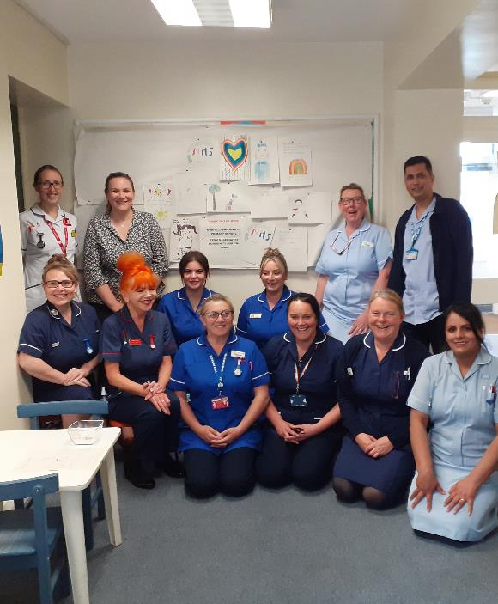
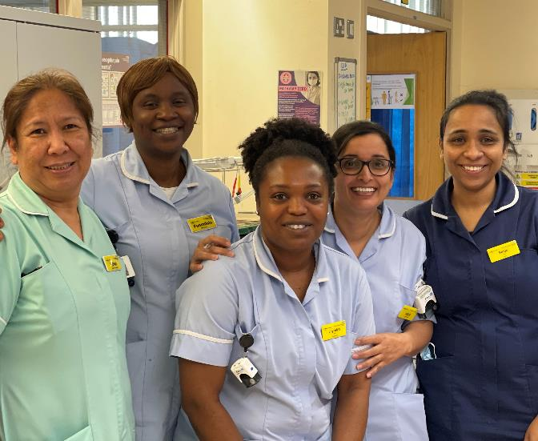
Better Care,
Better Together

Slide 2
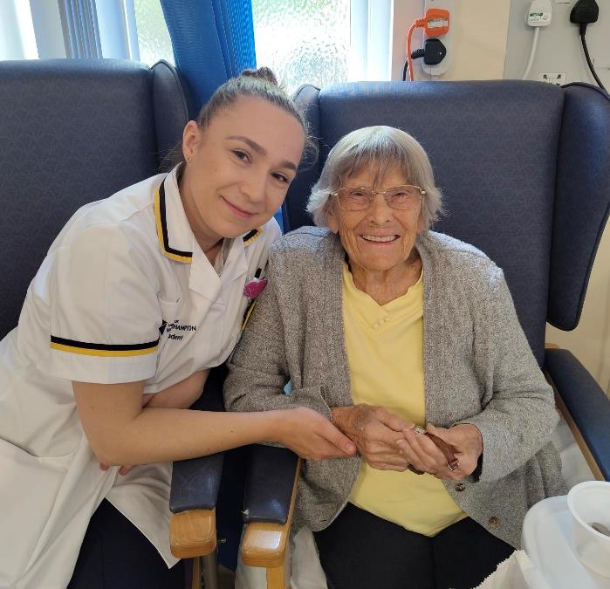
Better care by working together
One NHS: focused on our patients
Together we know how to improve care and deliver value for everyone
Phase one: recruiting a shared Chief Executive
Phase two: exploring options to form a Group:
  Shropcom and SaTH working together
  Two separate statutory organisations – one leadership team
We are working with other NHS trusts who have done this successfully

Slide 3
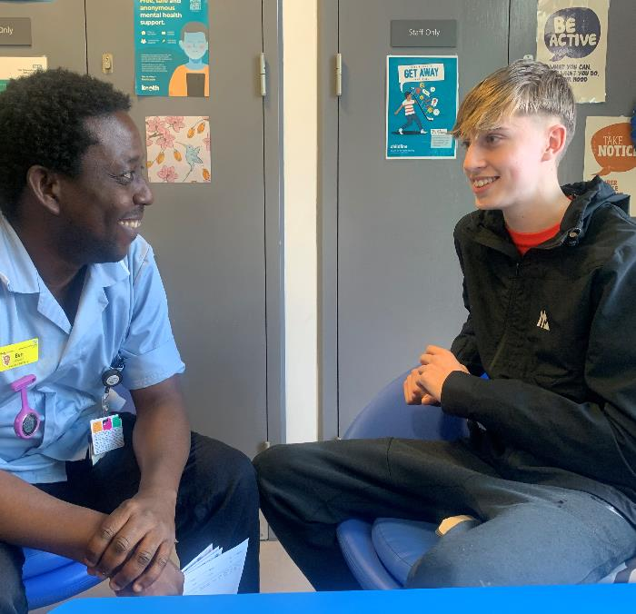
Building on our progress
We have many local examples of the benefits of working together:
  Chair in Common appointed Summer 2024
  Chief People Officer across both HR teams
  Shared Procurement service
  Joint working: Virtual Ward, Rehabilitation Wards, Outpatient Parenteral Antimicrobial Therapy (OPAT), Vaccinations
Shared leadership will increase joint working, removing barriers for patients and colleagues

Slide 4
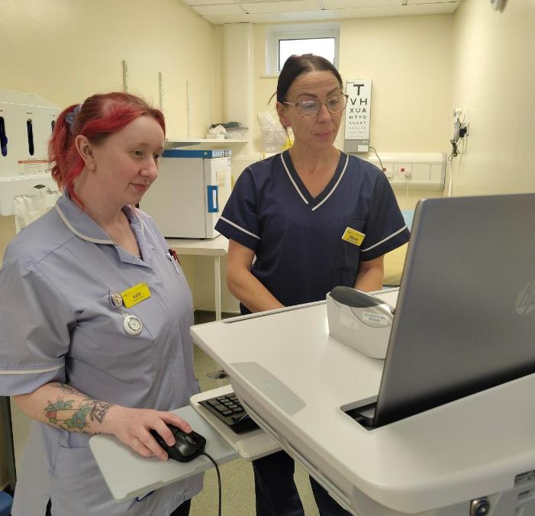
What does this mean?
The Trusts will remain as two separate statutory (legal) bodies:
Separate legal responsibilities
Separate finances
Two Governing Boards – but with shared membership

Slide 5
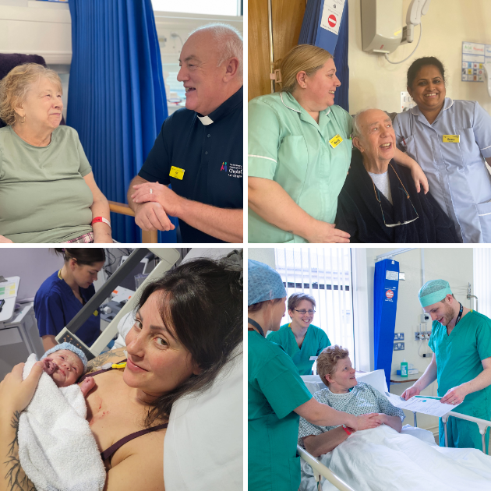
Why change?
Two small trusts coming together – gives us a bigger voice and more opportunities
Learning from other organisations who have formed Groups
Many staff live and work locally – we want to deliver the best care
Together we have the ideas - we want to take control of our own destiny:
  More care in the community helping patients stay well for longer – realising the left shift
  Value for patients and taxpayers
  Supporting our staff – better career opportunities, shared training and development
  Releasing more time and money for investment – digital

Slide 6
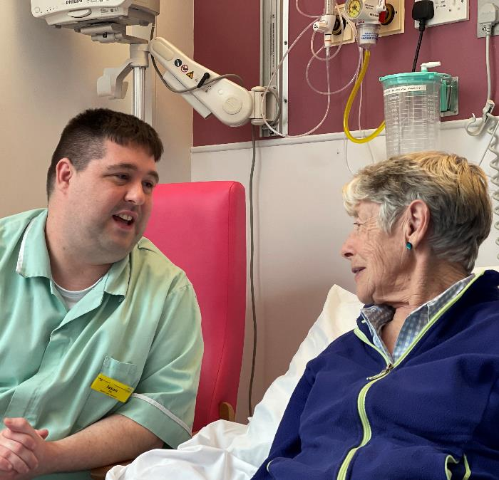
How does this affect me?
These changes mainly affect our Board leadership
We remain two separate statutory organisations
Over time, through shared leadership and direction, we hope everyone will see benefits…

Slide 7
Look ahead in five years…
If we get this right, we can deliver better care for patients:
Release investment for more services in the community - patients treated closer to home
Improve flow between our community and acute services:
  Joined up pathways for patients
  Reduced waiting times
  Reduced risk of patients deconditioning in our services
Improve quality of care – sharing learning and best practice
Deliver more multi-disciplinary services – teams wrapped around neighbourhood needs
Better communications between teams – improving patient care, sharing knowledge and ideas for change
Patients able to self-care – access to more digital tools
Making the most of our shared estates to support neighbourhood services
What change would you like to see in your area?

Slide 8
Look ahead in five years…
Creating a better working environment for staff:
More resilience in smaller teams – supporting staff to stay healthy and reduce burnout
Quicker, joined-up decisions – shared priorities, shared leadership, less bureaucracy
Faster deployment of staff to critical areas under pressure
Better career opportunities – rotations, shared roles across patient pathways
Connecting professionals – multi-professional learning and pathway development
Growing our staff – shared training and development
Attracting talent – more opportunities
Reduce reliance on agency, with the right staff, with the right skills in the right places
More digital transformation – giving staff the tools they need to deliver modern care
More opportunities for innovation and research
What change would you like to see in your area?

Slide 9
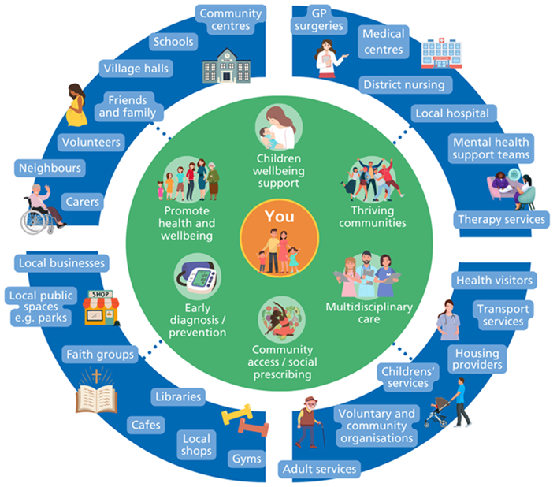
The future: neighbourhood working
Both organisations need to get ready for 2028…
  Local Care Plan – services in the community
  Hospitals Transformation – two thriving hospitals
Neighbourhood working is the future
Working closer together we can:
  Release the investment to fund neighbourhood care
  Build a wellness rather than an illness service
  Early advice and support
  Empower patients and staff through modern tools
  Tackle inequalities

Slide 10
What happens next?
If your network/ group would welcome a conversation about the changes, please contact us
Listening to the ideas and suggestions of staff – art of the possible – May/June 2025
Working with partners/ stakeholders – May/June 2025
Recruiting our shared Chief Executive – Summer 2025
Gaining approval from both Boards – Summer/Autumn 2025
Gaining NHS England assurance – Summer/Autumn 2025
If approved, developing our shared vision and values as a Group – working with staff and patients – 2025/26
Redesigning our Board – 2025/26

Slide 11
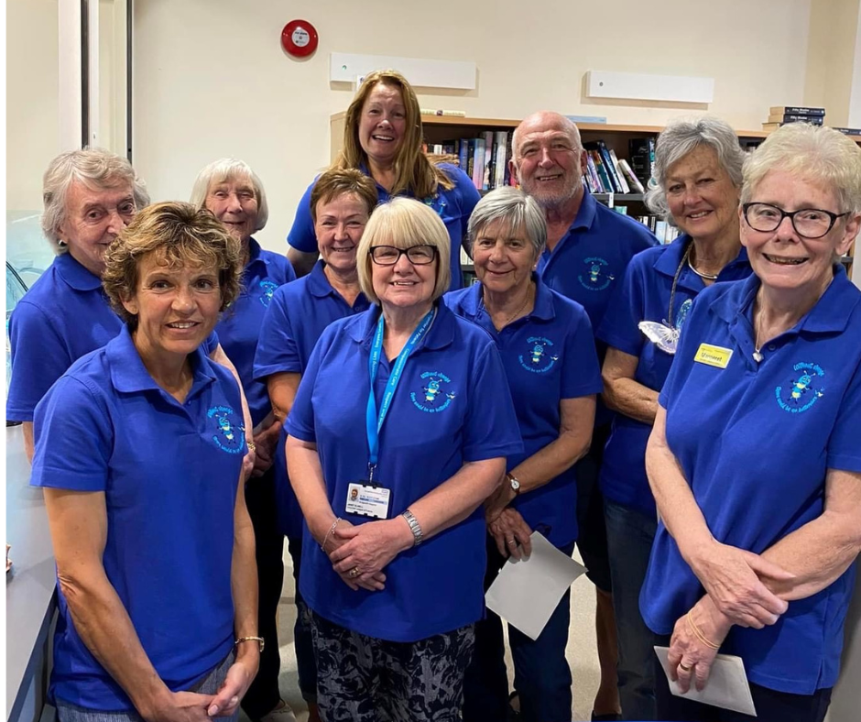
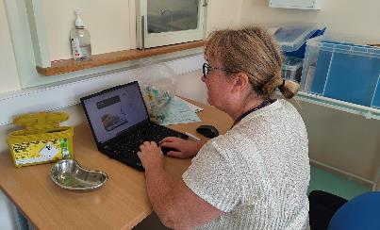
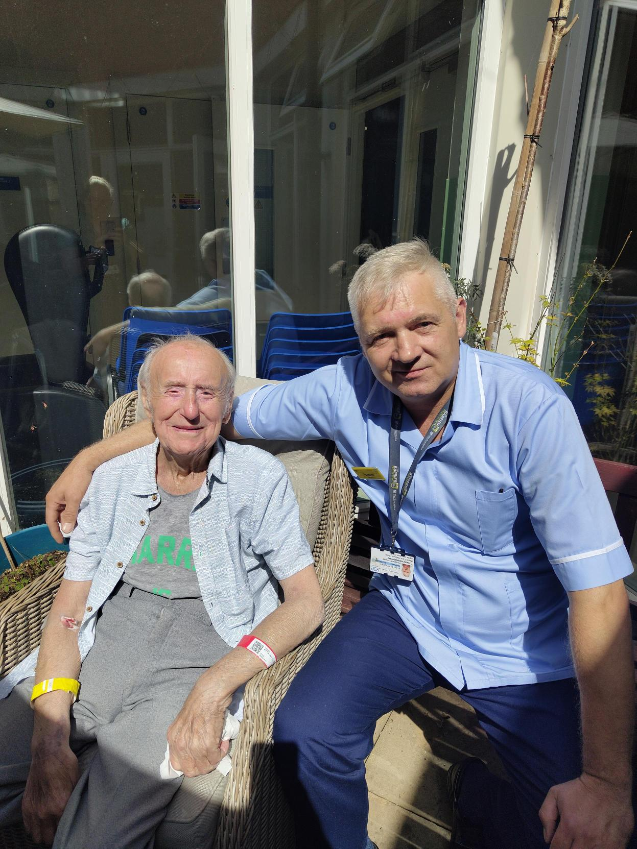
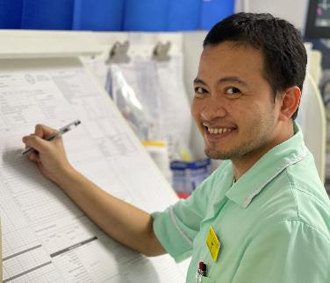
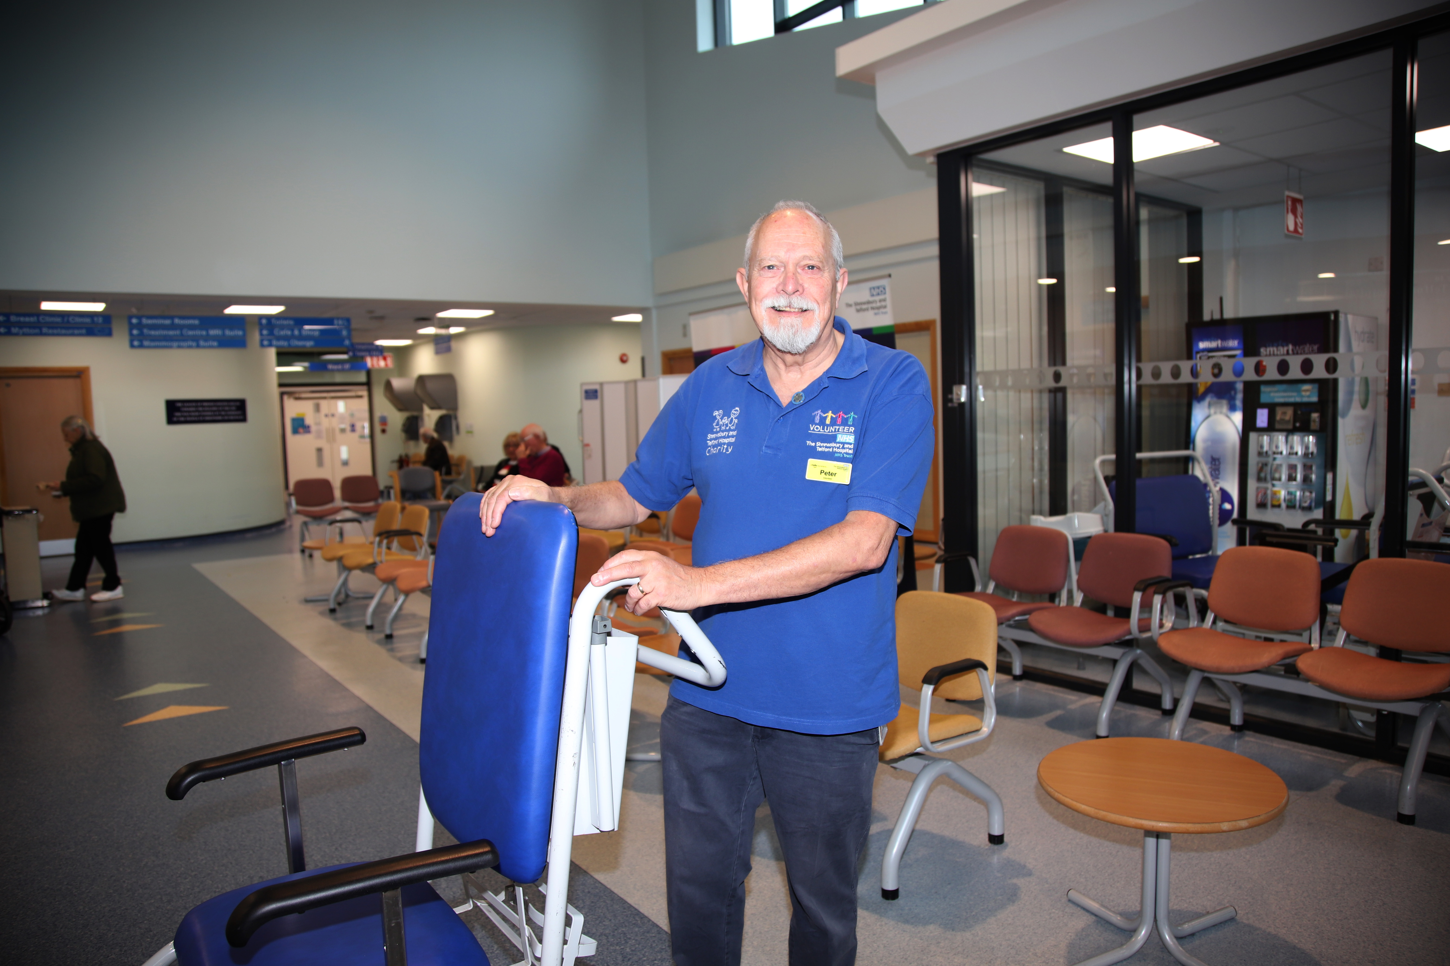
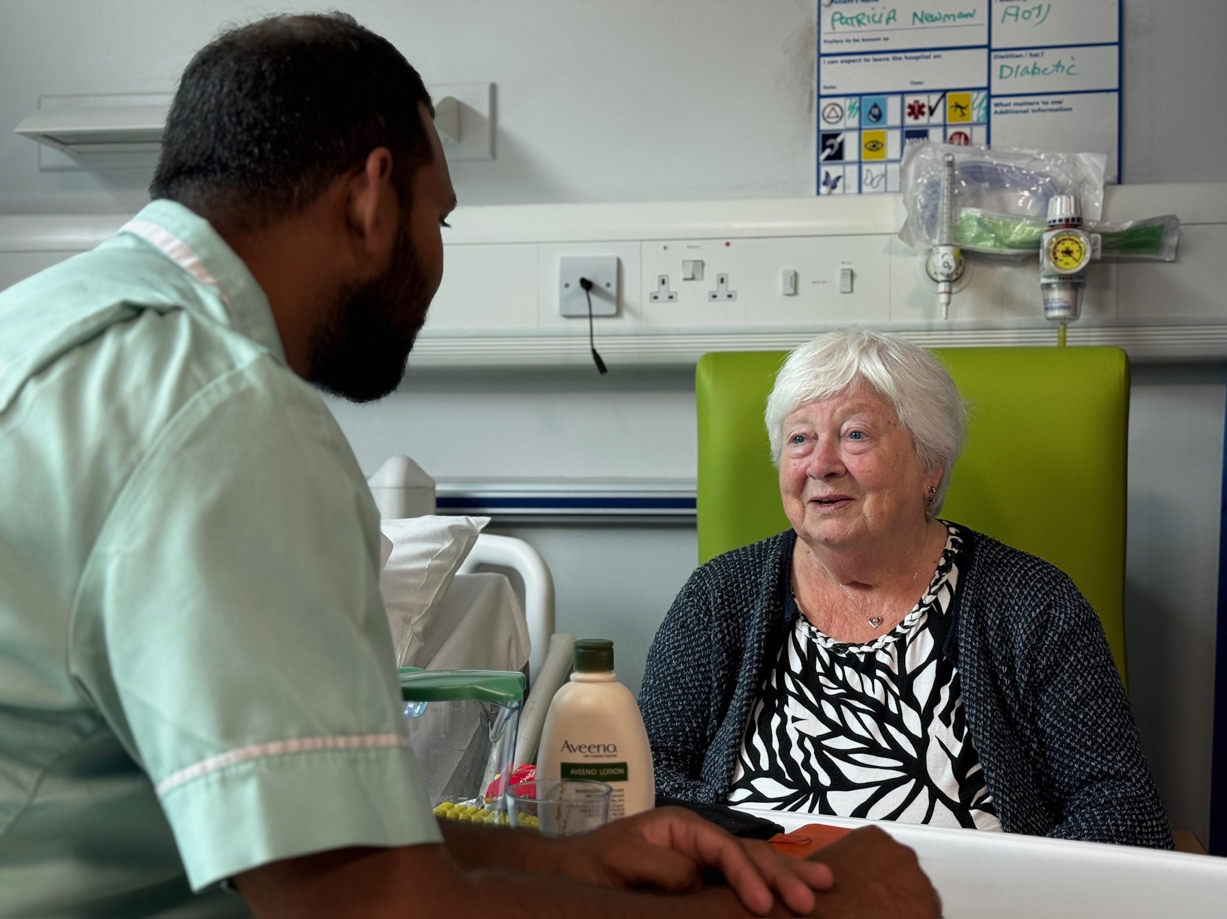
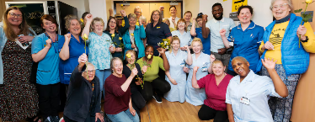
One NHS working together
One goal – better care and value for patients and a better work environment for staff
Be part of the change

Slide 12

Thank you for listening

