Slide 1
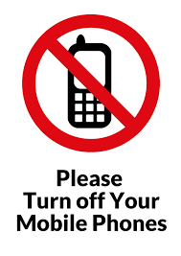

Slide 2
Colorectal Pre-Assessment
The aim of this presentation is to give you further information
regarding your CT planning scan, your Radiotherapy treatment and a
discussion about the importance of your bowel and bladder
preparation.

Slide 3
Bowel and Bladder preparation
If you have a stoma the following bowel prep will not apply to you.
Bowel prep consists of using Laxido and Simeticone (Wind-eze)for 3 days before your Planning CT scan: and for 3 days before starting treatment.
Laxido: 2 sachets a day, This is a very mild laxative which helps encourage a regular bowel movement. It is a powder which you add to 125ml of water and drink.
Simeticone:(Wind-eze) 3 tablets spread through the day - these tablets help reduce bloating and trapped wind.

Slide 4
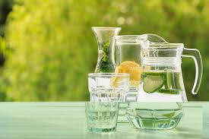
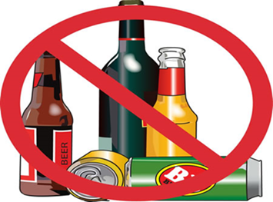
Hydration
Bladder prep consists of hydrating by drinking 1 litre of still water on a daily basis starting from today. This is on top of hot drinks which should be decaffeinated.
Please avoid fizzy drinks and alcohol.

Slide 5
The importance of Bowel /Bladder prep
The aim of the bowel and bladder prep is to make the bladder full, so it is lifted out of the treatment field.
The rectum needs to be empty of bowel gas and faeces so that it is as small as possible.
This will enable your consultant to create the best treatment plan for you, whilst minimising side effects to these areas.

Slide 6
CT Planning Scan.
On the day of your CT appointment, you will need to ensure you have drunk at least 500ml of water at home.
You arrive at the Lingen Davies dept for your appointment time. A radiographer will speak to you, you will be asked to empty your bladder and drink 500ml water. Please do not do this until you have been spoken to by a radiographer.
There will be a wait of 30 minutes for your bladder to fill sufficiently.

Slide 7
IV (Intravenous) Contrast?
IV Contrast (only if your consultant requests it).
This is administered via a cannula inserted into a vein usually on the back of your hand. IV contrast helps to enhance the scan images to aid the consultant in planning the treatment area.
Please ensure you drink plenty of water afterwards to flush this contrast out of your system.
You may be asked to remain in the department for 30 minutes afterwards for observation.

Slide 8
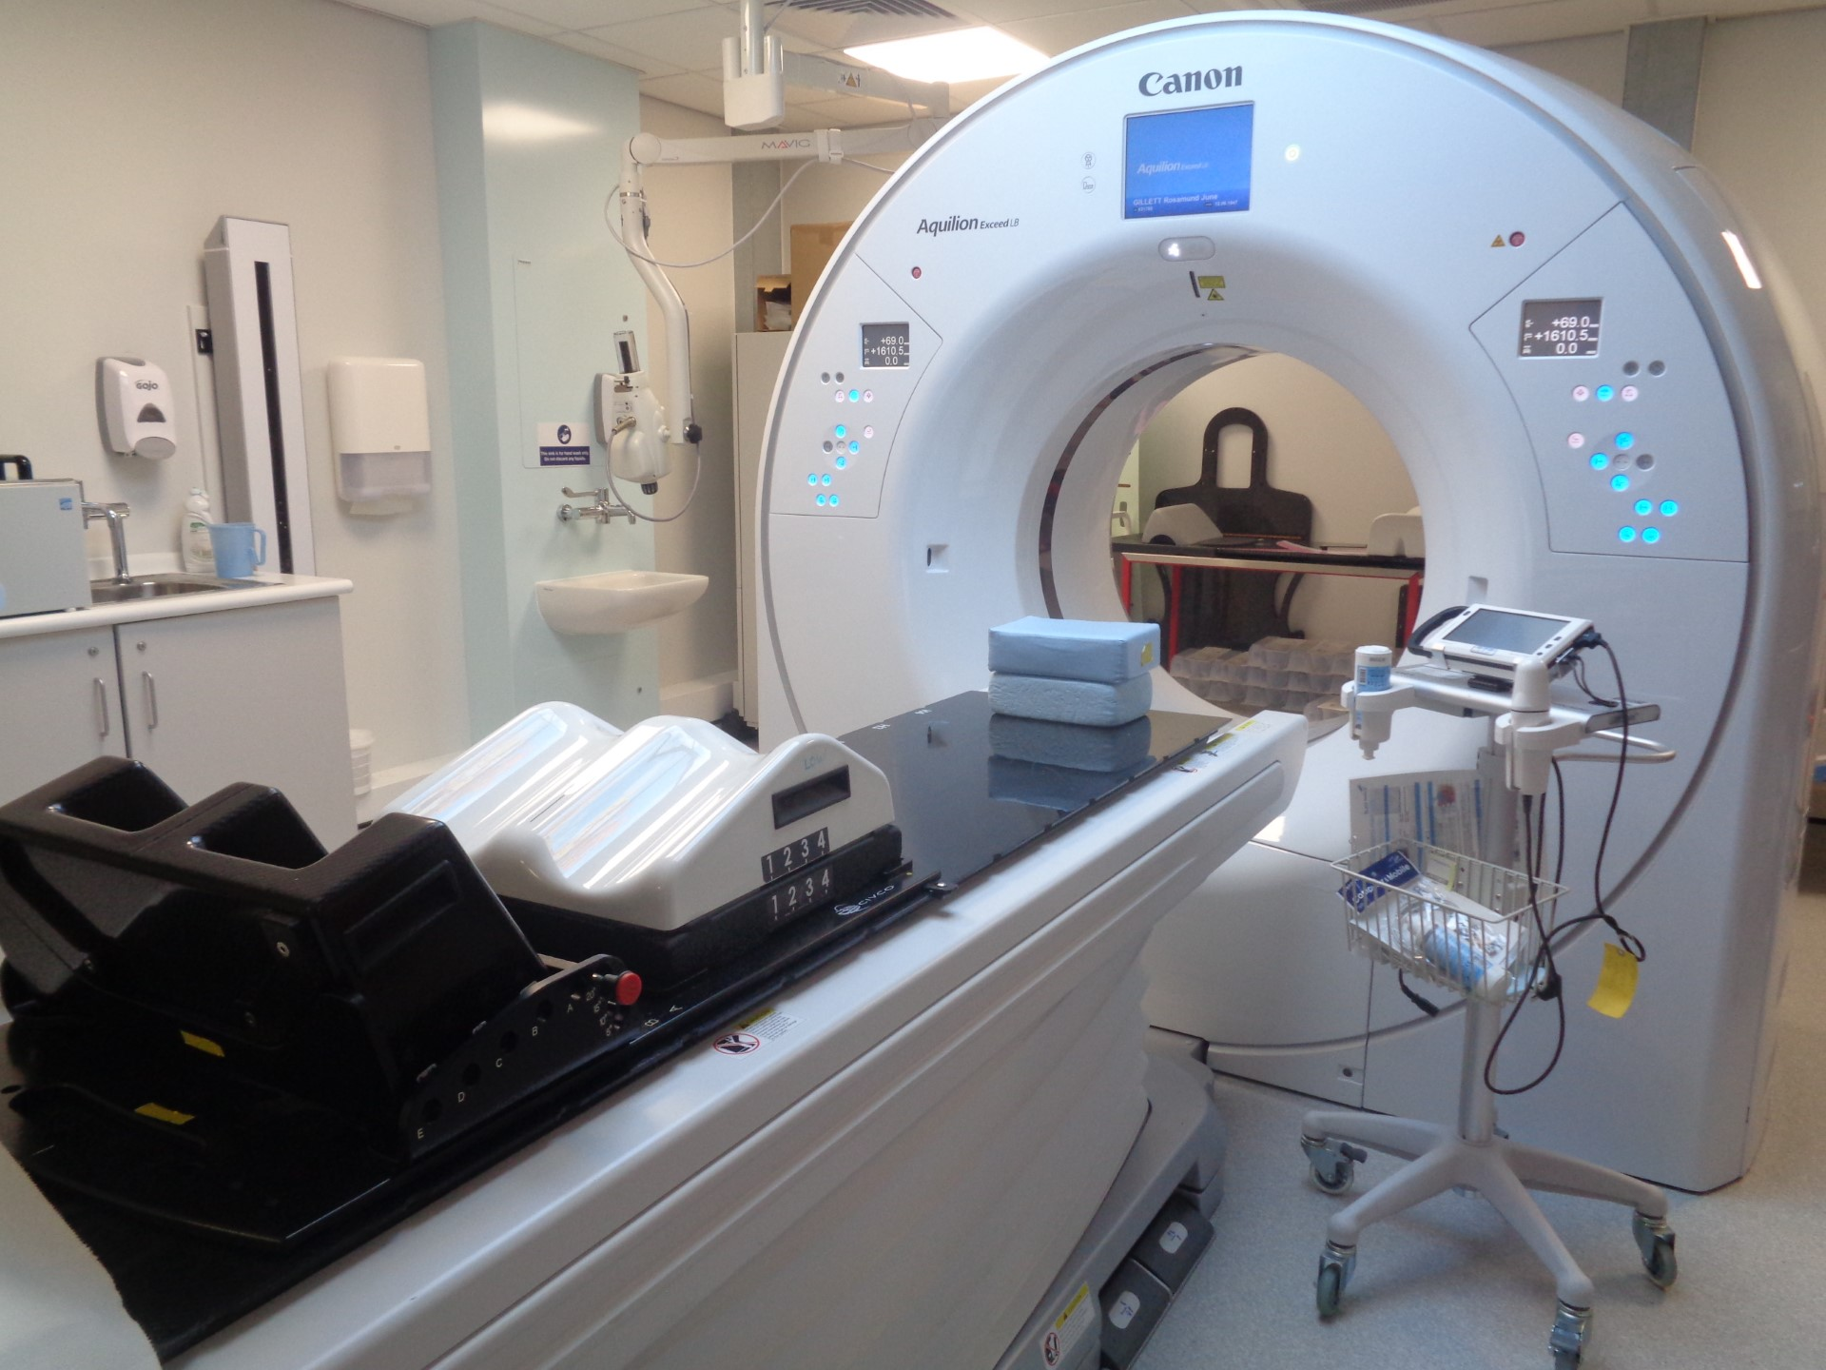
The CT Scan
We do an initial scan of your pelvis to check for gas and faeces, if either are present, we may not be able to perform the CT scan that day, but we will discuss this with you.
We perform an ultrasound of your bladder to make sure it is full enough, if not full enough we can leave you for 10 minutes to see if it fills sufficiently. If the bladder does not fill, you will be sent home to hydrate for a further 48 hours.
Your consultant may have asked for us to use a bolus, this will be created at your CT appointment, so it is ready for your Radiotherapy treatment. Bolus is a tissue equivalent material which brings the radiotherapy dose to the skin surface.
Your consultant may be present at the CT appointment.
Your consultant may have asked the radiographer to use a rectal marker (for CT appointment only).

Slide 9
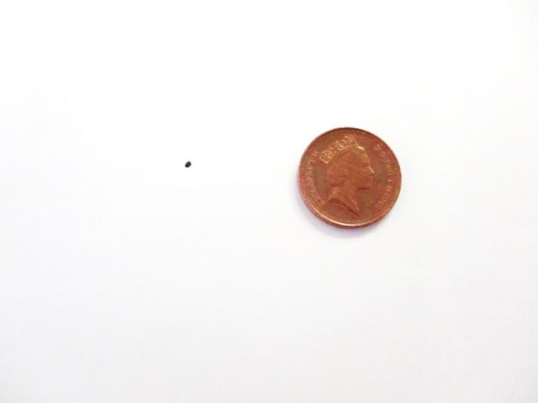
Tattoo.
This is the approximate size of the tattoo.
There will be 3 of these tattoos . These are positioned on the most stable point on your pelvis.
The radiographers use these tattoos on a daily basis to set you up in the same position every-time you have your treatment.

Slide 10
Planning your Radiotherapy Treatment.
The images from the CT planning scan are used by your consultant to plan your radiotherapy treatment.
All treatment plans are created for each individual person.
You will be in the same position for treatment as you were at your CT scan.

Slide 11
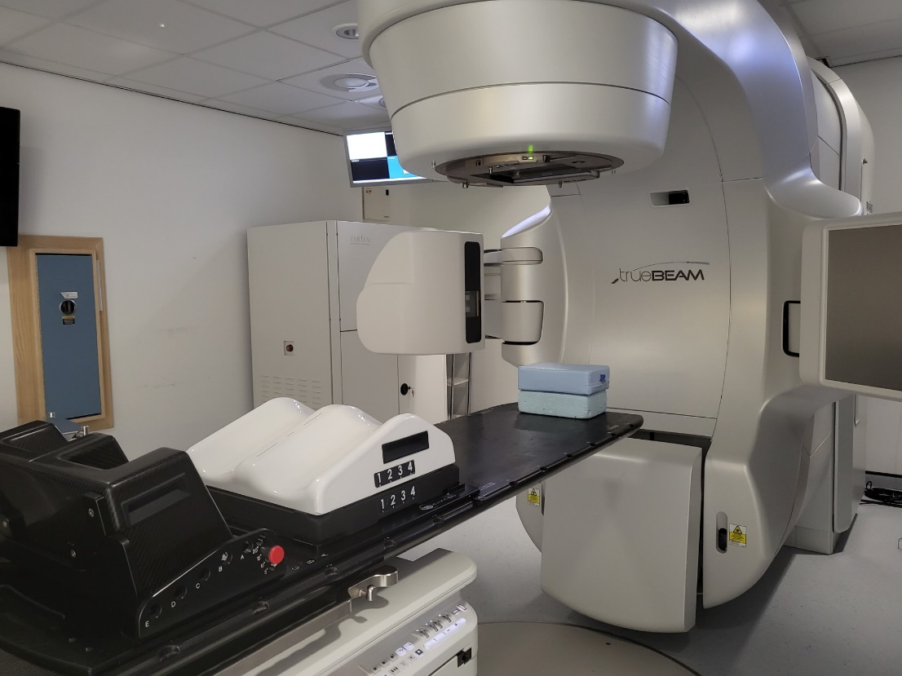
Image of treatment machine.
The treatment comes from this part of the machine.
These arms come out to take an x ray image daily to check you are in the correct position.
There will be a radiographer either side of you. They will align your pelvis tattoos up with the laser lights positioned in the room.
It is important to keep as still as possible. The treatment machine will move around you, but it will not touch you at any point.
You will not feel anything during your treatment.
The machine makes a buzzing noise, this is normal.
We are watching you on our cameras and if you need us you can raise your hand and we will come back into the room.

Slide 12
What do I need to bring with me?
Please bring a dressing gown with you as you will need to change before your treatment.
Slip on shoes or slippers.
Your 500ml bottle of water.

Slide 13
Skin Care and self help
It is important to moisturise the area being treated. We recommend twice daily and there is no need to wash off the cream prior to your treatment. Just ensure it is well absorbed!
Exercise daily, this helps relieve gas.
Eat regularly (little and often) to help avoid a build up of gas.
Hydrate by drinking your 1 litre of water daily; (and over the weekends)!

Slide 14
Appointments
You will be given your start date and time for treatment at your CT scan.
On your first day of radiotherapy, you will be given the rest of that weeks’ appointment times. You will be given your following weeks’ appointment times each Friday.

Slide 15
The Review Radiographer
You will be seen by one of our Review Radiographers during your treatment.
They will check how you are feeling and treat any side effects you may experience.
They also ensure that you have all the information you need during your course of treatment.

Slide 16
What happens after I finish treatment?
You can expect your treatment reactions to continue for up to 2-3 weeks after your course of treatment
You will be given a follow up appointment with your doctor for approximately 6 – 8 weeks after you finish your treatment

Slide 17
Car Parking
You will be able to park for free for all of your Radiotherapy treatments including today.

Slide 18
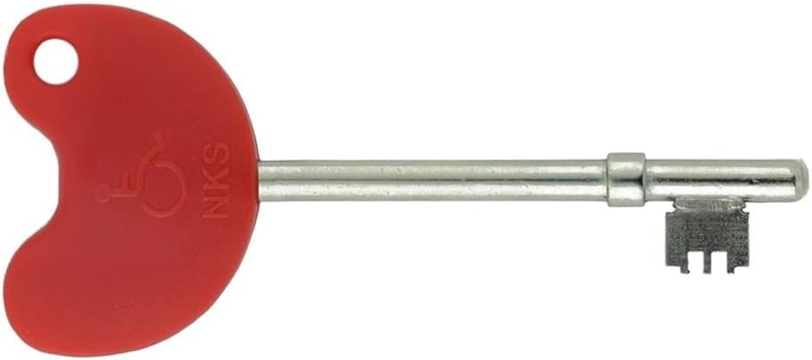
Radar Key
If anyone would like one of these Radar Keys, please call into the Lingen Davies to obtain one. All you need is your postcode.

Slide 19
Just to re-cap
Laxido and Simeticone for 3 days BEFORE CT and 1st TREATMENT
Hydrate from today, 1 litre of still water per day, (on top of hot drinks which need to be decaffeinated). Including weekends.

