Slide 1


Slide 2

Prostate Pre-Assessment
The aim of this presentation is to give you further information
regarding your CT planning scan, your Radiotherapy treatment and a
discussion about the importance of your bowel and bladder
preparation.

Slide 3
Bowel and Bladder preparation
Bowel prep consists of using Laxido and Simeticone (Wind-eze or INFACOL)for 5 days before your Planning CT scan: and for 5 days before starting treatment.
Laxido: This is a very mild laxative which helps encourage a regular bowel movement. It is a powder which you add to 125ml of water and drink.
Simeticone: (Wind-eze OR Infacol) will help reduce bloating and trapped wind.

Slide 4


Hydration
Bladder prep consists of hydrating by drinking 1 litre of still water on a daily basis starting from today. This is on top of hot drinks which should be de-caffinated.
Please avoid fizzy drinks and alcohol.

Slide 5

Micralax Enema
Micralax enema: this is used at home on the day of your CT scan.
Use it 30 minutes before leaving home. It usually works within 20 minutes.
It will only work if there is faeces there and may also help reduce any wind/gas. It is important to use it even if you have been naturally beforehand.
Before each radiotherapy treatment please ensure you also use an enema at home before attending the department.

Slide 6
The aim of the bowel and bladder prep is to make the bladder full, so it is lifted out of the treatment field.
The rectum needs to be empty of bowel gas and faeces so that it is as small as possible to avoid the rectum being included in the treatment area.
This is to minimise side effects to these areas.

Slide 7
CT Planning Scan.
Use your Micralax enema 30minutes before leaving home. It will work within 20 minutes.
You arrive at the Lingen Davies dept for your appointment time. A radiographer will speak to you, you will be asked to empty your bladder and drink 500ml water. Please do not do this until you have been spoken to by a radiographer.
You will be taken into the CT scanning room 15 -30 minutes after you have completed your drinking.

Slide 8
IV (Intravenous) Contrast?
IV Contrast (only if your consultant requests it).
This is administered via a cannula inserted into a vein usually on the back of your hand. IV contrast helps to enhance the scan images to aid the consultant in planning the treatment area.
Please ensure you drink plenty of water afterwards to flush this contrast out of your system.
You may be asked to remain in the department for 30 minutes afterwards for observation.

Slide 9
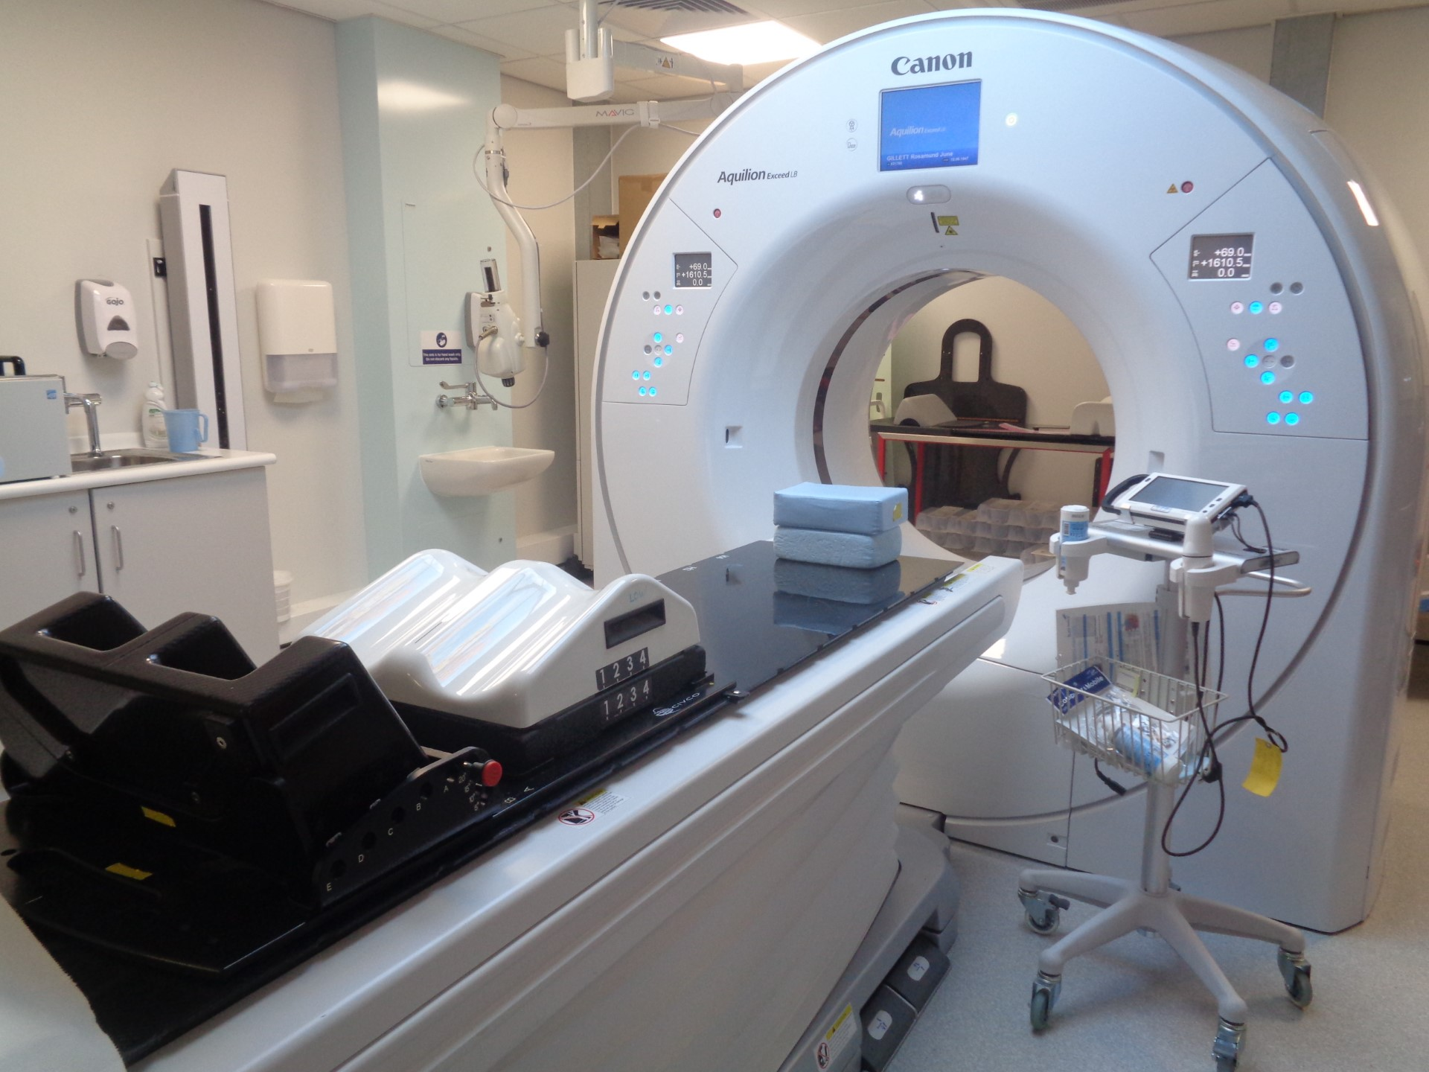
The CT Scan
We do an initial scan of your pelvis to check for gas and faeces, if either are present, we may not be able to perform the CT scan that day, but we will discuss this with you.
We perform an ultrasound of your bladder to make sure it is full enough, if not full enough we can leave you for 10 minutes to see if it fills sufficiently. If the bladder does not fill, you will be sent home to hydrate for a further 48 hours.

Slide 10
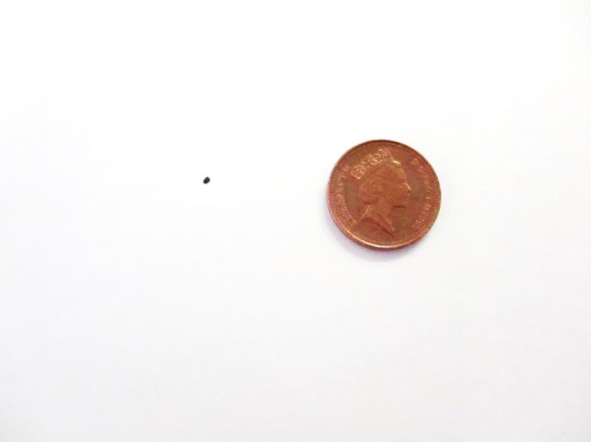
Tattoo.
This is the approximate size of the tattoo.
There will be 3 of these tattoos . These are positioned on the most stable point on your pelvis.
The radiographers use these tattoos on a daily basis to set you up in the same position every-time you have your treatment.

Slide 11
Planning your Radiotherapy Treatment.
The images from the CT planning scan are used by your consultant to plan your radiotherapy treatment.
All treatment plans are created for each individual person.
After a successful CT planning scan, you will be given your radiotherapy start date.

Slide 12
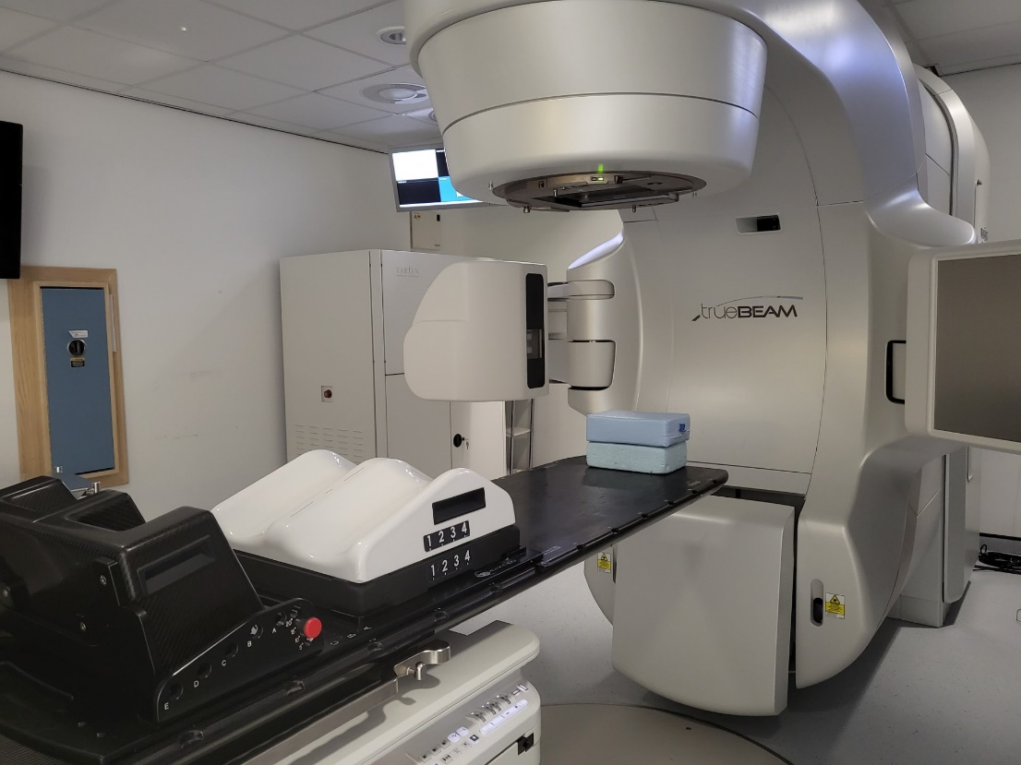
Treatment machine
It is important to keep as still as possible. The treatment machine will move around you, but it will not touch you at any point.
You will not physically feel anything during your treatment.
The machine makes a buzzing noise, this is normal. There is also music playing in the room.
There will be a radiographer either side of you. They will align your pelvis tattoos up with the laser lights positioned in the room.
We are watching you on our cameras and if you need us you can raise your hand and we will come back into the room.
These arms come out to take an x ray image daily to check you are in the correct position.

Slide 13
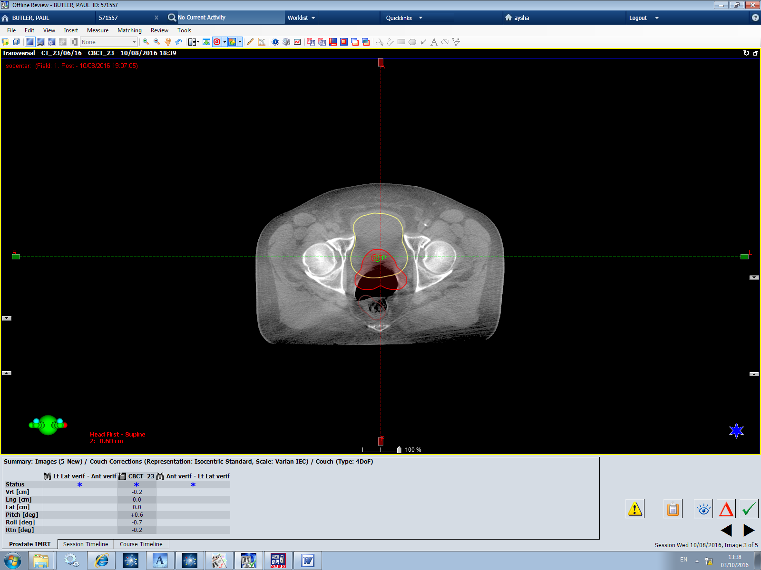
What this means for you.
Images are done daily to ensure the prostate is in the correct position.
The yellow outline is the bladder.
The red outline is the area we want to treat.
The brown outline is the rectum.
This image shows a ball of gas which is pushing the rectum into the treatment area. We would ask you to get off the bed to try and dispel it, as treating you on this would increase your side effects.

Slide 14
Skin Care and self help
It is important to moisturise the area being treated. We recommend twice daily and there is no need to wash off the cream prior to your treatment. Just ensure it is well absorbed!
Exercise daily, this helps relieve gas.
Eat regularly (little and often) to help avoid a build up of gas.
Hydrate by drinking your 1 litre of water daily; (and over the weekends)!

Slide 15
The Review Radiographer
You will be seen by one of our Review Radiographers during your treatment.
They will check how you are feeling and treat any side effects you may experience.
They also ensure that you have all the information you need during your course of treatment.

Slide 16
What happens after I finish treatment?
You can expect your treatment reactions to continue for up to 2-3 weeks after your course of treatment
You will be given a follow up appointment with your doctor for approximately 6 – 8 weeks after you finish your treatment
You usually have a blood test to check your PSA one week prior to your follow up appointment.

Slide 17
Car Parking
You will be able to park for free for all of your Radiotherapy treatments including today.

Slide 18
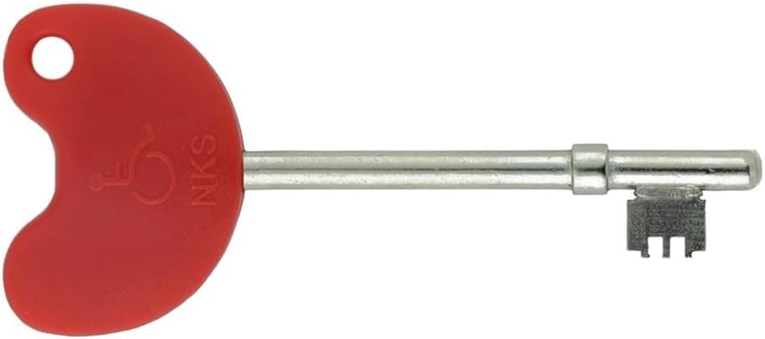
Radar Key
If anyone would like one of these Radar Keys, please call into the Lingen Davies to obtain one. All you need is your postcode.

Slide 19
Just to re-cap
Laxido and Simeticone (Wind-eze or INFACOL) for 5 days BEFORE CT and 1st TREATMENT APPT
Micralax enema daily (takes up to 20 minutes to take effect)
Hydrate from today, 1 litre of still water per day, plus additional drinks, including weekends.

Slide 20
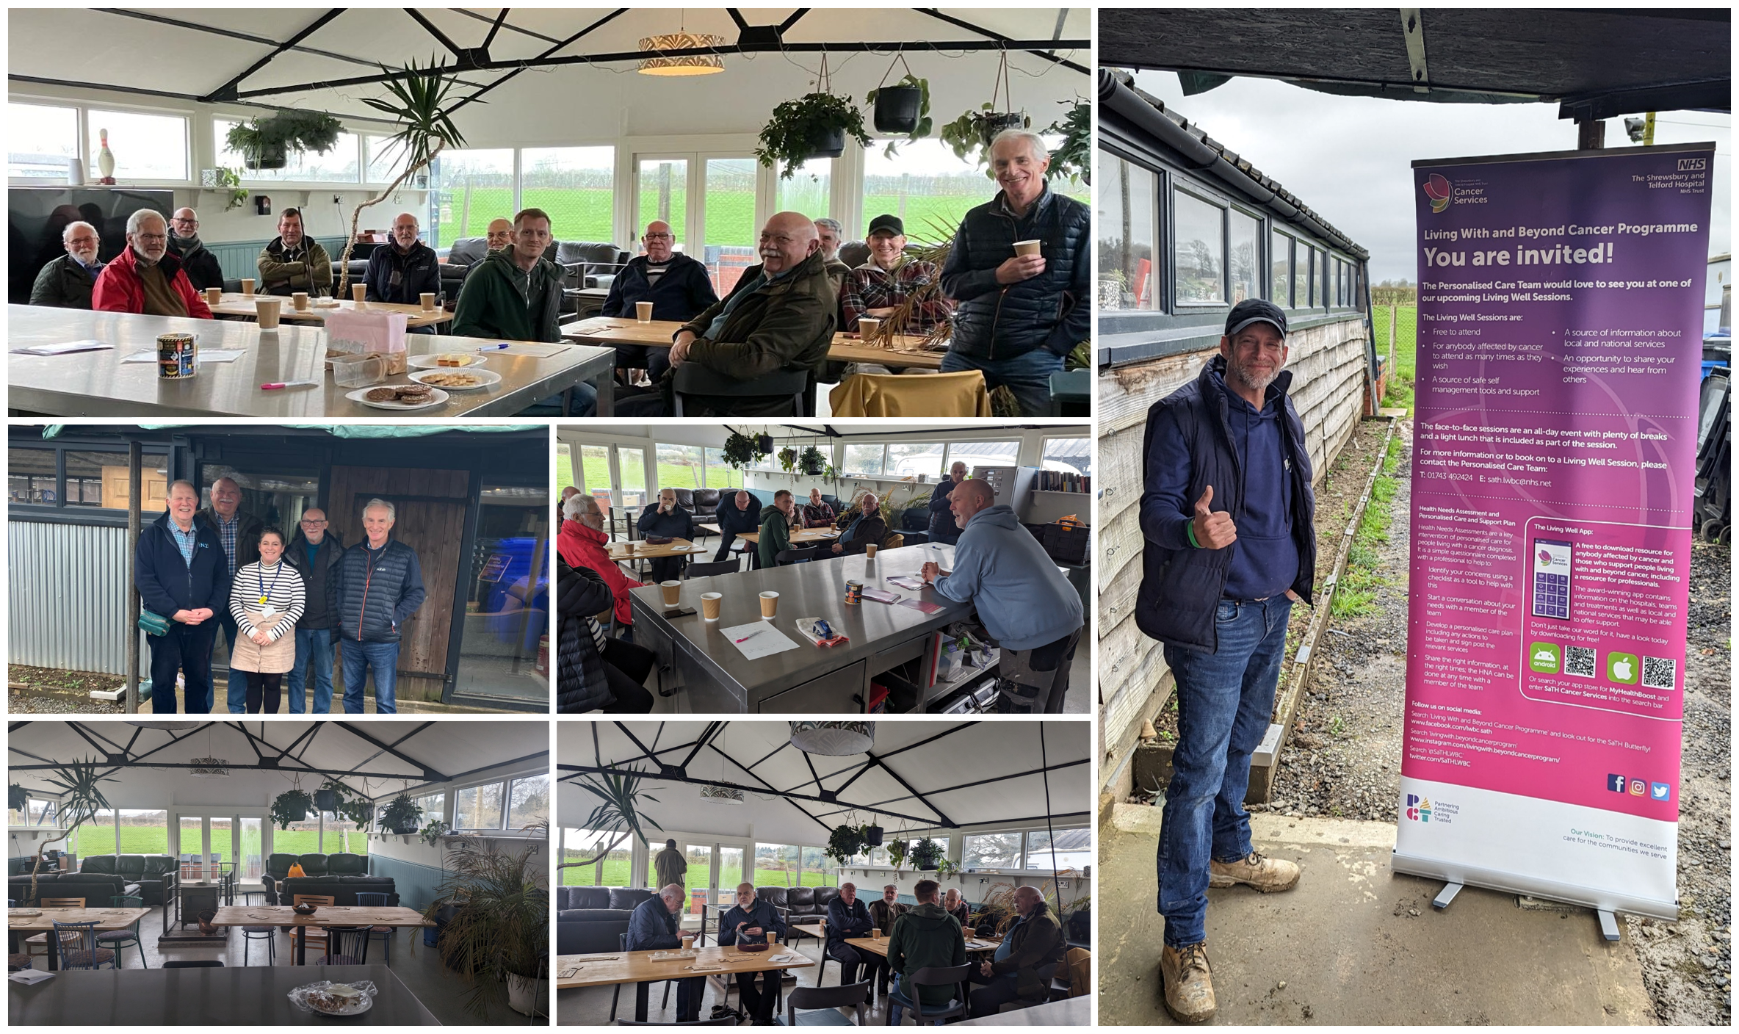

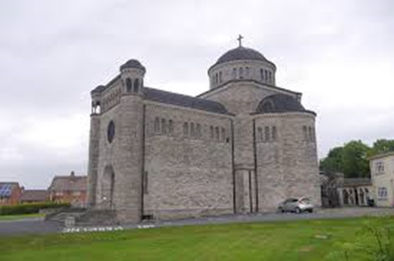
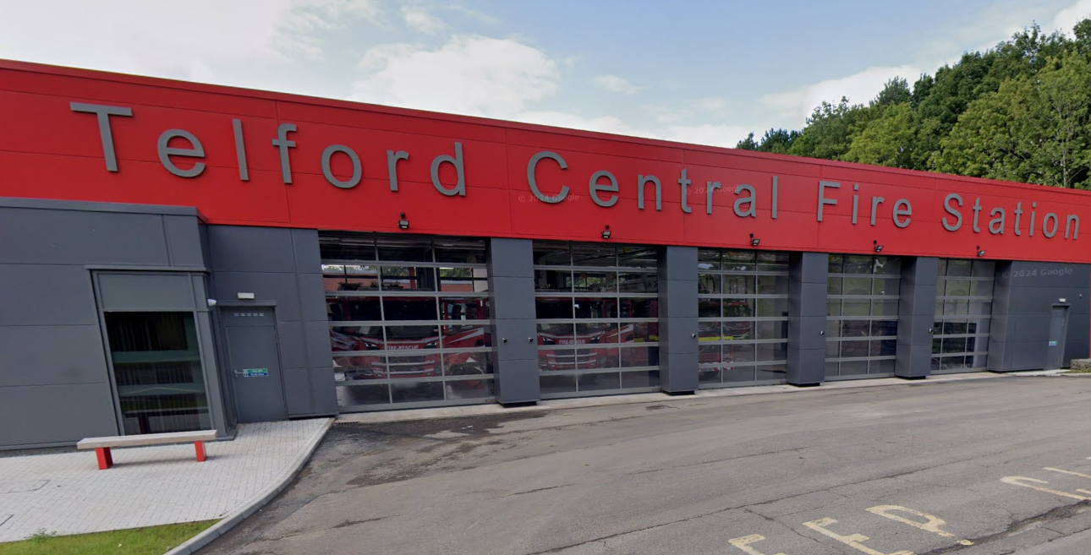
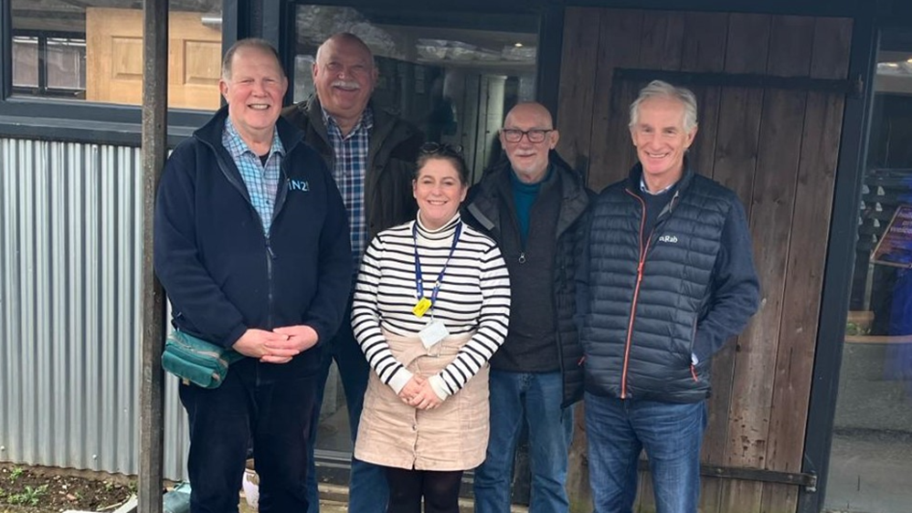
‘Men Like Us’
A Cancer Support Group, run by men for men run by Shrewsbury and Telford Hospital NHS Trust (SaTH) & volunteers;welcomes any man that is affected by cancer to join them for practical & emotional support.
Shrewsbury ‘Men Like Us’
Shrewsbury Men's Shed, West Mid Show Ground, Gravel Lane, SY1 2PF
Last Thursday of the month 1pm-3pm.
Ludlow ‘Men Like Us’
St Peters Catholic Church, Henley Road, SY8 1QZ
First Tuesday of the month 2pm-4pm.
Telford ‘Men Like Us’
Telford Central Fire Station
1 Stafford Park 1, Telford TF3 3BW
Second Wednesday of the month 10am- 12am.
For more information, please contact the team on: 01743 492424 or email sath.lwbc@nhs.net
No need to book, just turn up for a very warm welcome and a brew!

