Slide 1
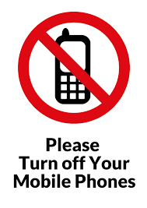

Slide 2
Your Radiotherapy Treatment

Slide 3
What is Radiotherapy?
High energy x-rays that are delivered by a machine called a linear accelerator.
If child bearing age (up to age 55) you are advised NOT to become pregnant prior to and during treatment. You will be asked to sign a declaration at your CT appointment
Notes:
There will be a radiographer either side of you and they will move you into the correct position using the SGRT system fixed in the treatment room.

Slide 4
Arm mobility
It is important to have good arm mobility so you can achieve the position we require for your CT scan and for treatment. You will be in this treatment position for up to 15 - 20minutes for your CT appointment and for your radiotherapy treatment.
If you have any arm mobility issues, and unsure if you can maintain the arm position needed for your CT scan and treatment, please can you let us know today.
It is really important to carry on with the exercises you have been given by the breast care nurses.

Slide 5
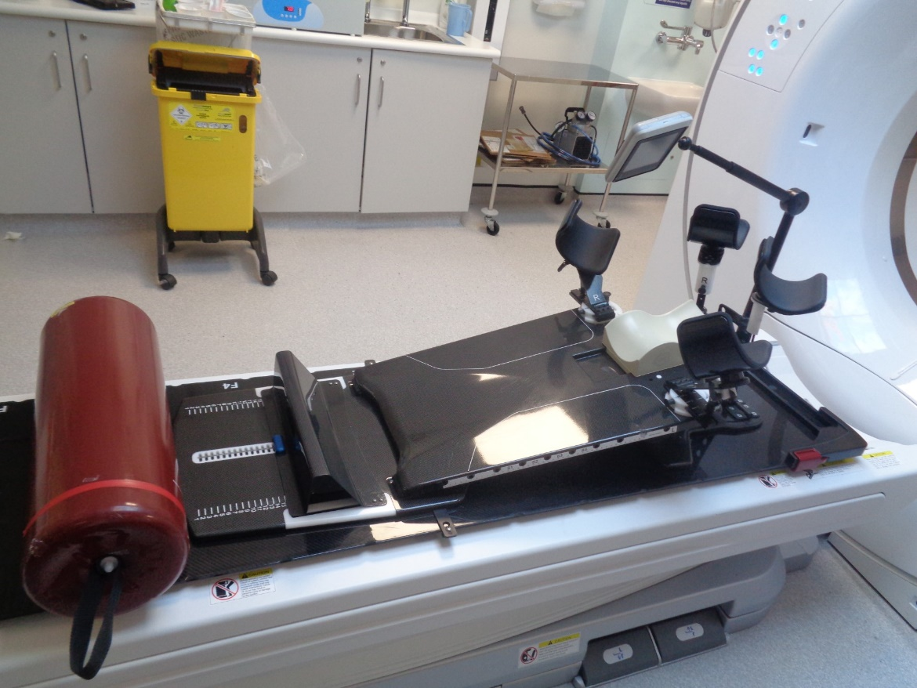
Positioning equipment used.
Adjustable arm cups, head cushion and bottom wedge are all designed to help keep you in exactly the correct position during your CT appt and during your radiotherapy treatment.

Slide 6
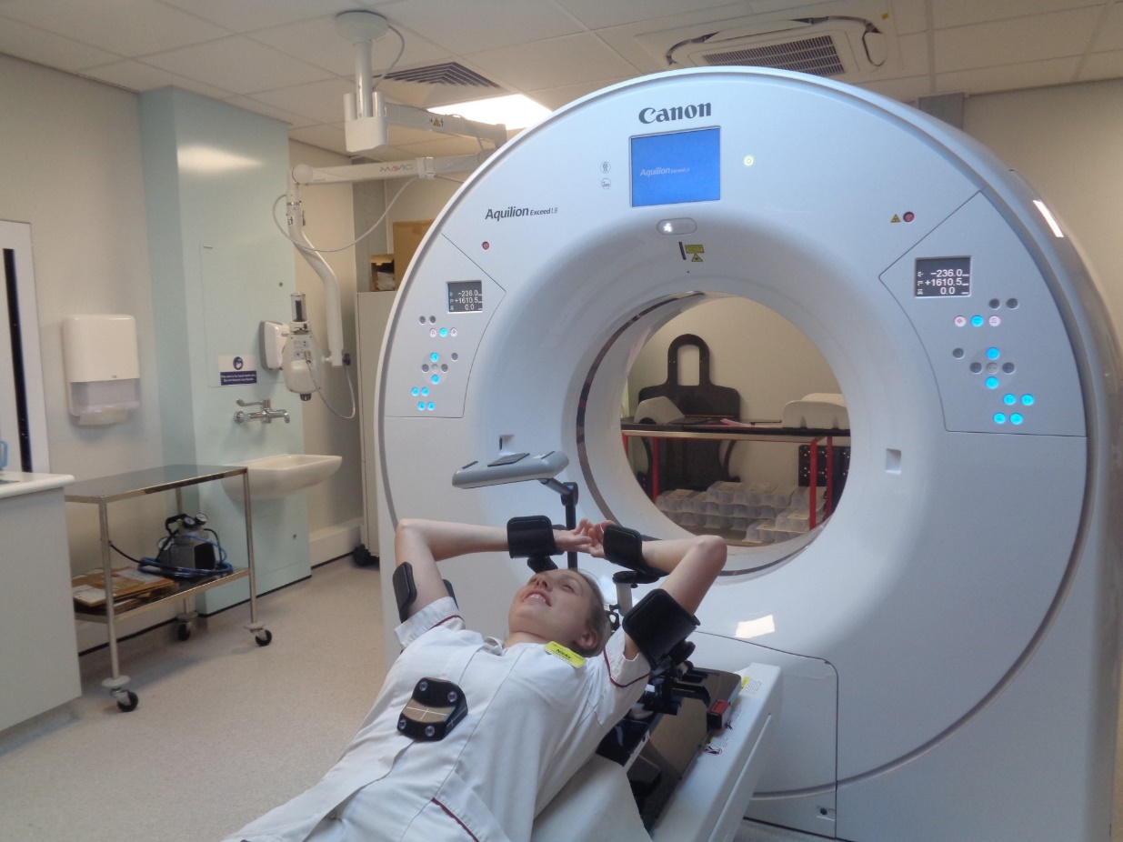
CT SCANNER
Adjustable eye screen so you can see your breathing trace.
This breathing marker box is positioned on your mid diaphragm and will help us to track your breathing with the help of cameras at the bottom of the treatment couch.

Slide 7
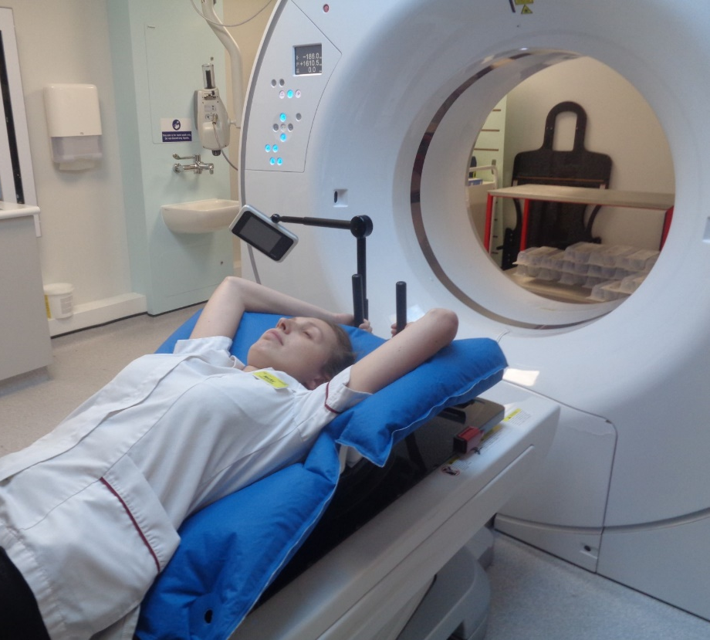
Alternative Equipment Used
We may need to make a vac bag which is also used to aid positioning.
This is like a bean bag, it is moulded around you, the air is taken out. This then becomes rigid and used during your CT scan and radiotherapy.

Slide 8
CT SCAN
Although you will need to remove all of your top items of clothing, you are able to wear a thin strapped loose camisole/vest top which will need to be lowered to your waist prior to your scan and treatment.
We will then put some fine wire on your scar using some tape. This is so that the scar will show up on the scan.
We will place some markers on your chest which will show up on the scan and help your consultant to plan your radiotherapy.

Slide 9
The CT Scan
It may be necessary to take some digital photographs of the position you are in so we can reproduce this when having your treatment. We will inform you if this is necessary before taking them.
During the scan the bed will move backwards and forwards through the scanner. You are not enclosed in the scanner.
The machine does make a whirring sound and the scan takes about 3 minutes. It is important for you to stay as still as possible!

Slide 10
IV Contrast
You will only be given contrast if your Consultant has asked for it. If you are for contrast we will discuss this with you.
Having contrast highlights the lymph nodes making it easier for the Consultant to accurately plan your treatment.
A Radiographer will insert a cannula into a vein on the back of your hand or arm.
It is important to be hydrated before and after this procedure to flush the contrast out of your system.

Slide 11
Deep Inspiration Breath Hold Technique
This technique is used for all left sided breast patients, however this may also apply to some right sided breast patients too!

Slide 12
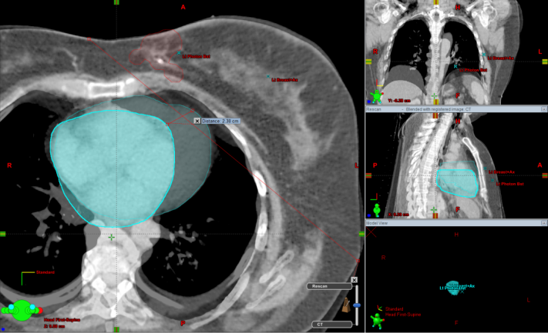
What is DIBH?
A radiotherapy technique in which you are required to hold your breath at various points
By holding your breath, the position of your heart will move away from where we are treating with radiation
This will minimise the risk of damage to your heart and reduce long term side effects
Practice holding your breath for up to 30 seconds in the treatment position
Free Breathing
Breath Hold

Slide 13
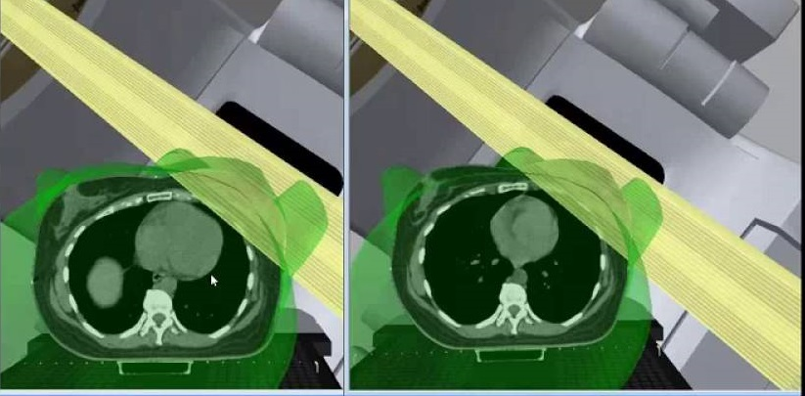
A sneak peak inside
Free Breathing
Breath Hold

Slide 14
The Breathing Technique
Breath in through your nose
Keep your mouth closed
Ensure you hold at an acceptable level for you – this will help you achieve holding your breath for 30 seconds

Slide 15
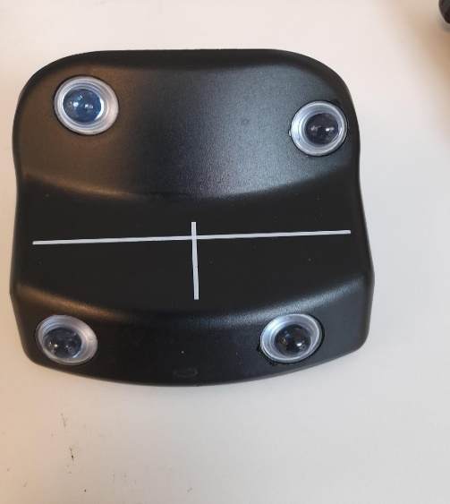

The radiographers will put on a small rectangular box on to the lower part of your chest.
The dots on this box will pick up your breathing trace and send it to our computer

Slide 16
Once your breathing is tracked you will be given a screen to look at
On this screen you will see the breathing screen
The radiographers will ask you to hold your breath at regular intervals

Slide 17


The Breathing Screen
We will ask you to take a deep breath in, we then set the green box to your individual breath hold.
The aim is to get the white bar into the green box.
The white line will move up and down following your breathing pattern.

Slide 18
Once your breathing pattern is consistent we will be ready to scan you
You will need to hold your breath during the scan – approximately 30 seconds

Slide 19
What if I can’t manage?
Please don’t worry if you are unable to hold your breath
We are still able to offer you an alternative radiotherapy technique
We are able to shield your heart using leaves of lead that are in our machines.

Slide 20
Re-assurance whilst having the treatment
During your course of treatment you will need to hold your breath at various points as instructed by the radiographers.
If you cough or are unable to hold at those points please don’t worry, the treatment machine is programmed to know if your breath hold is in the correct position and will not switch on if it isn't.

Slide 21
What will happen when I start treatment?
On your first day you will be collected from reception by a member of staff.
The procedure will be explained to you and you will have the opportunity to ask questions.
You will be asked to change into a dressing gown or something similar so that there is only one layer to take off in the treatment room. You can still wear a loose vest top underneath which can be lowered once on the treatment bed.

Slide 22
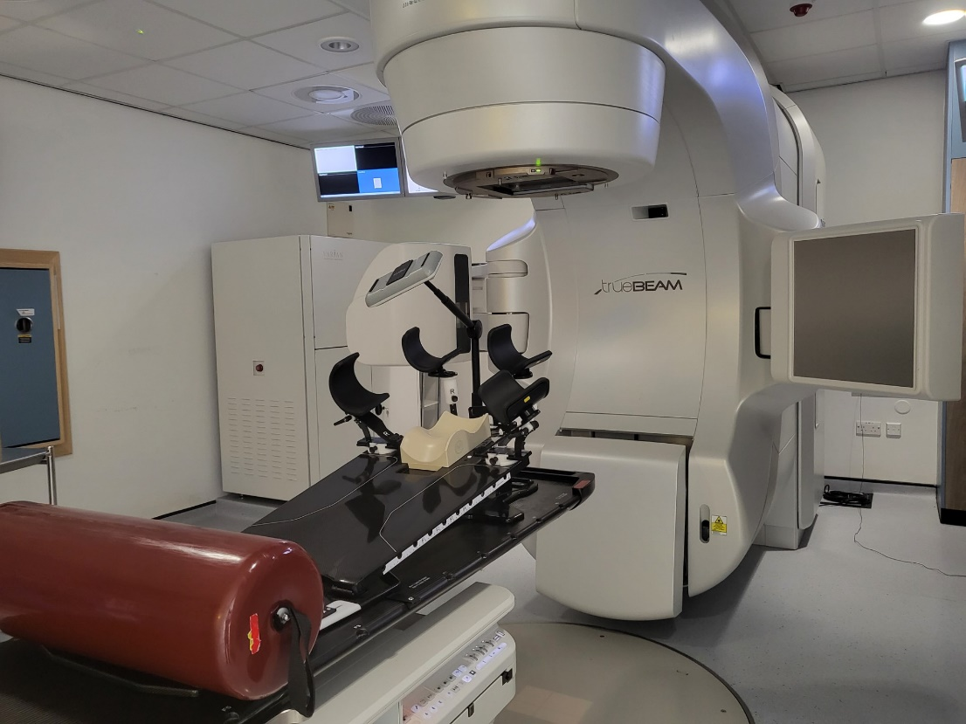
Treatment Machine
The treatment
The treatment
comes from this part of the machine.
There will be a radiographer at the side of you to help move you into the correct position.
We take an x ray image daily to ensure you are in the correct position for your treatment.

Slide 23
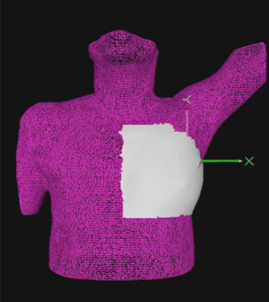
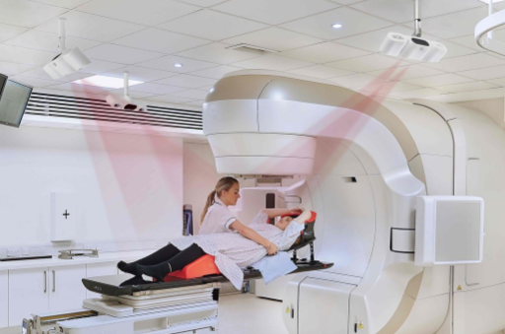
Surface Guided System
No need for tattoos
3 infrared cameras on the ceiling will be used to help align you for your treatment using thousands of point, so you may notice a red light at times.
Notes:
The surface guided system allows us to set you up without the need for permanent tattoos. It will monitor your breathing and movement and switch of the treatment if you move too much.

Slide 24
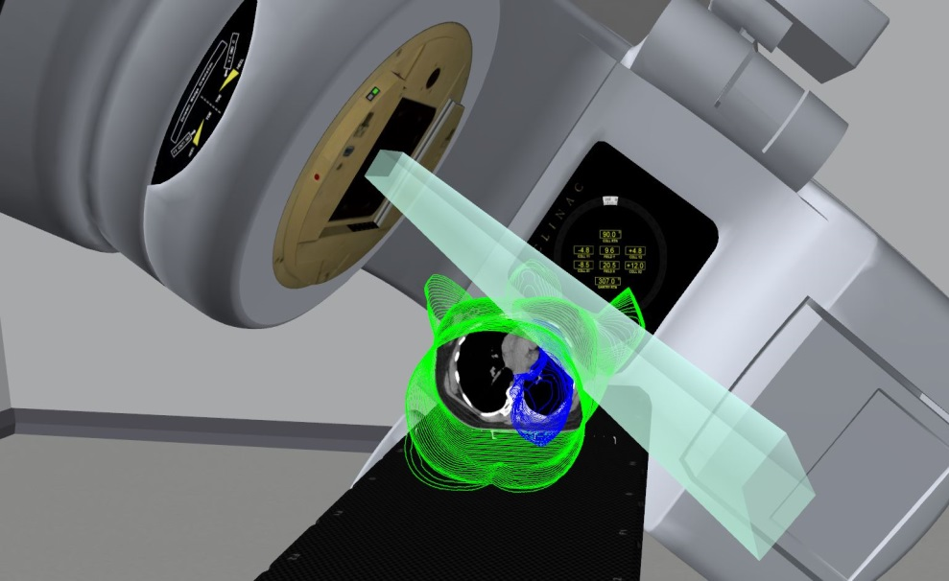
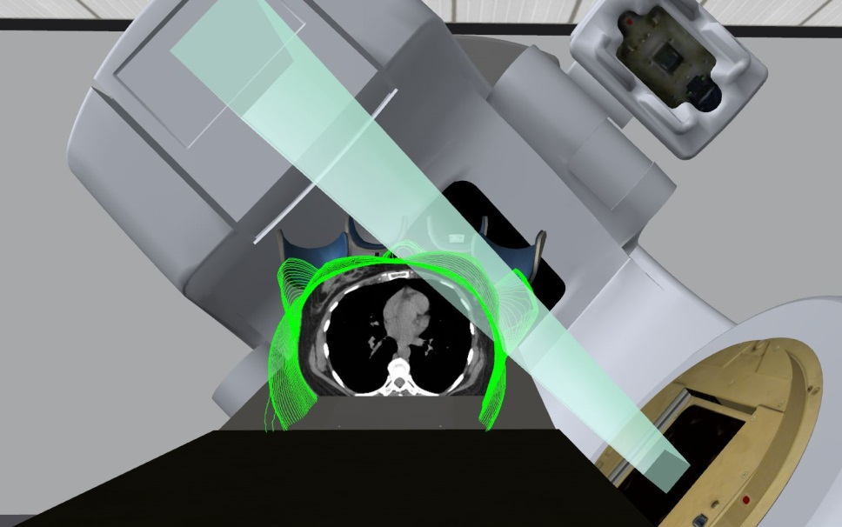
The Radiation Beam Position
The treatment machine will move around you, but it will not touch you at any point. It is really important to keep as still as possible at all times.

Slide 25
Who will treat me?
We have male and female radiographers in the dept
We work in small teams, there will be a minimum of 2 radiographers at each treatment session.
We also have students who are training for their degree who are supervised by qualified Radiographers at all times.
We have Care Assistants who assist with non – treatment procedures.

Slide 26
The Review Radiographer
You will be seen by one of our Review Radiographers during your treatment
They will check how you are feeling and treat any side effects you may experience.
They also ensure that you have all the information you need during your course of treatment.

Slide 27
Will I have any side effects?
The main side effect is skin redness/ soreness, breast swelling/discomfort and you can also feel tired during this time.
There are also longer term side effects which may happen months/years after and may be permanent. These can be found on your consent form.

Slide 28
Skin Care
It is really important to moisturise the area being treated. It is difficult at this stage to know where the treatment fields will be but, you need to ensure from your earlobes to rib cage, front and back are moisturised. We recommend twice daily, there is no need to wash off the cream prior to your treatment. Just ensure it is well absorbed!
You may wear deodorant throughout your treatment.
Avoid clothes that are tight fitting and under wired bras as this may cause friction and irritation.
Avoid sun exposure to the area having treatment.

Slide 29



Self-help tips
Hydration, a varied diet and gentle exercise may be beneficial during this time.

Slide 30
What happens after I finish treatment?
You can expect your treatment reactions to continue for up to 2 – 3 weeks after your course of treatment so please carry on with your skin care routine.
You will be given a follow up appointment with your doctor for approximately 6 – 8 weeks after you finish your treatment

Slide 31
Appointments
You will be given your start date for treatment at your CT scan.
You will only be given the time for your first day of treatment and on that 1st day you will get the times for the rest of the week.
You will be given your other treatment appointment times each Friday.
Please notify the Radiographers of any other medical appointments you may have ASAP to allow us to plan in advance.

Slide 32
COVID ?
If you become unwell before or during your course of treatment; please take a lateral flow test. If this gives a positive result please contact the department.
We will still be able to treat you, but we will need to put additional protection in place to safeguard other patients’ and the radiographers.

Slide 33
Car Park
You will be able to park for free for all of your Radiotherapy treatments including today.

Slide 34
Any concerns?
If you have any concerns regarding wound healing, swelling, redness, hot to touch, or fluid build-up (seroma) in the surgical area.
any arm mobility concerns.
please make a member of the team aware before you
leave today. We will arrange to take you back to the
department to be checked by a radiographer.
Thank you, any Questions?

