Slide 1
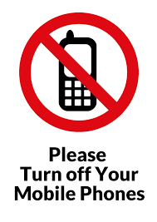

Slide 2
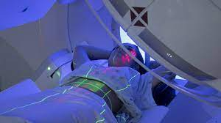
Radiotherapy
Your Treatment

Slide 3
Your Radiotherapy Treatment
The aim of this presentation is to give you further information regarding your CT planning scan, your Radiotherapy treatment and a discussion about the importance of your bowel and bladder preparation.

Slide 4
Aim of Bowel/Bladder prep.
The aim of the bowel and bladder prep is to make the bladder full, so it is lifted out of the treatment field.
The rectum needs to be empty of bowel gas and faeces so that it is as small as possible to avoid the rectum being included in the treatment area.
This is to minimise your side effects to these areas.

Slide 5

Bowel Prep
To minimise the size of your rectum, you will be required to take 3 days of Laxido and Simeticone, prior to your CT scan and your radiotherapy treatment.
Laxido: This is a very mild laxative which helps encourage a regular bowel movement. It is a powder which you add to 125ml of water and drink
Simeticone:(Wind-eze) these tablets help reduce bloating and trapped wind.

Slide 6

Bladder/Hydration
Bladder prep consists of hydrating by drinking 1 litre of still water on a daily basis starting from today. This is on top of hot drinks which should be decaffeinated.
Please avoid having fizzy drinks and alcohol.

Slide 7
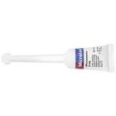
Microlax Enema
You will be required to use a mild enema for your scan and on the 1st day of your treatment.
Please use your enema 30 minutes before leaving home. It usually works within 20 minutes.
It will only work if there is faeces there and may also help reduce any wind/gas It is important to use it even if you have been naturally.

Slide 8
CT Planning Scan
On the day of your CT appointment, arrive at the Lingen Davies dept for your appointment time. A radiographer will speak to you, you will be asked to empty your bladder and drink 500ml water. Please do not do this until you have been spoken to by a radiographer.
There will be a wait of 15 - 30 minutes for your bladder to fill sufficiently.

Slide 9
IV(Intravenous) Contrast
IV Contrast (only if your consultant requests it).
This is administered via a cannula inserted into a vein usually on the back of your hand. IV contrast helps to enhance the scan images to aid the consultant in planning the treatment area.
Please ensure you drink plenty of water afterwards to flush this contrast out of your system.
You may be asked to remain in the department for 30 minutes afterwards for observation.

Slide 10
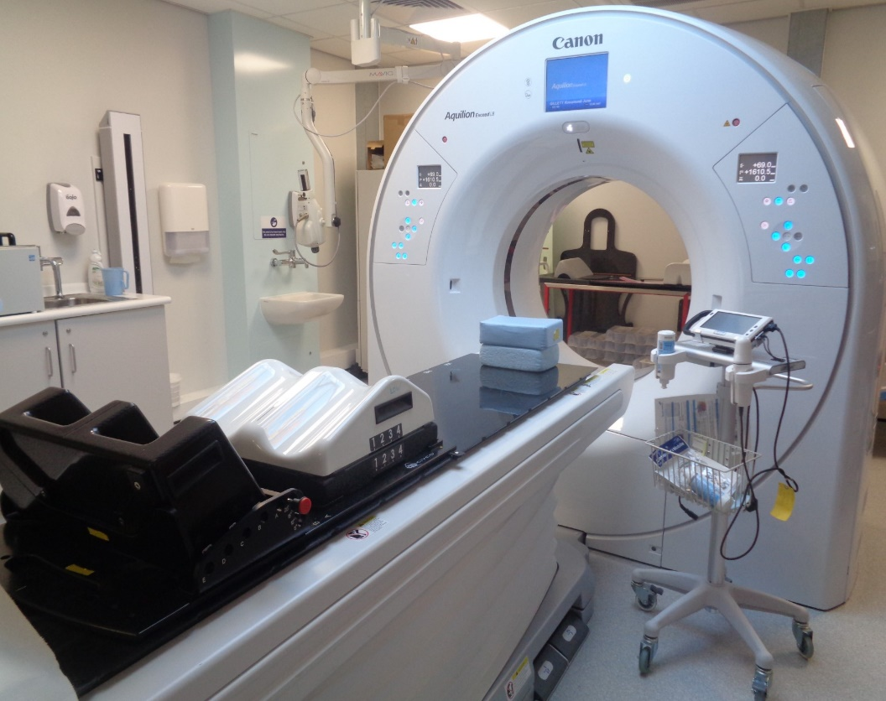
The CT Scan
We do an initial scan of your pelvis to check for gas and faeces, if either are present, we may not be able to perform the CT scan that day, but we will discuss this with you.
We perform an ultrasound of your bladder to make sure it is full enough, if not full enough we can leave you for 10 minutes to see if it fills sufficiently. If the bladder does not fill, you will be sent home to hydrate for a further 48 hours.

Slide 11
Markers
Your consultant may have asked the radiographer to use a vaginal marker (for CT appointment only).
Your consultant may be present at the CT appointment.
Your consultant may have asked for us to use a bolus, this will be created at your CT appointment, so it is ready for your Radiotherapy treatment. Bolus is a tissue equivalent material which brings the radiotherapy dose to the skin surface.

Slide 12
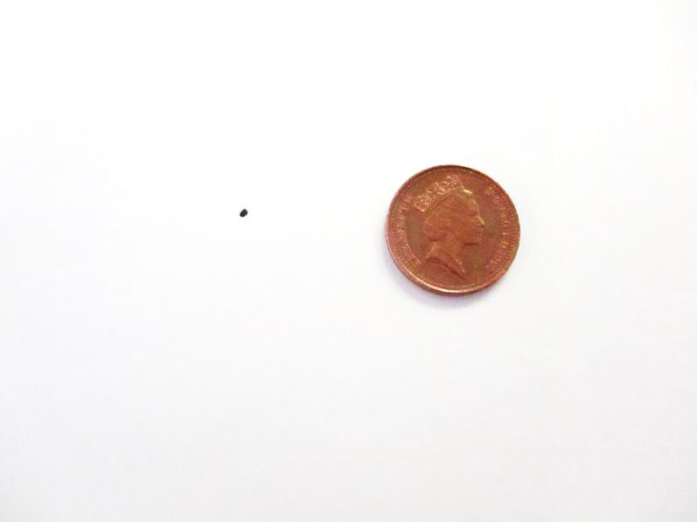
Tattoos
This is the approximate size of the tattoo
There will be 3 of these tattoos . These are positioned on the most stable point on your pelvis. They will be done after your CT scan.
The radiographers use these tattoos on a daily basis to set you up in the same position every-time you have your treatment.

Slide 13
Planning your Radiotherapy Treatment.
The images from the CT planning scan are used by your consultant to plan your radiotherapy treatment.
All treatment plans are created for each individual person.
You will be in the same position for treatment as you were at your CT scan.

Slide 14
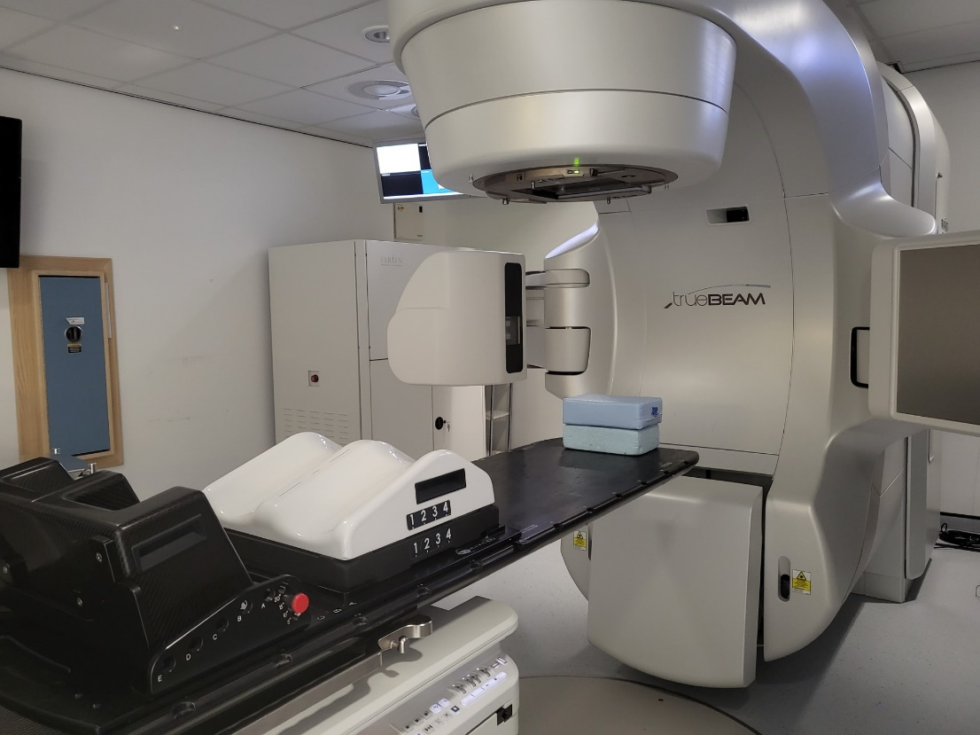
Image of treatment machine.
There will be a radiographer either side of you to help get you in to the correct position.
The treatment comes from this part of the machine.
We will take an x ray image daily to check you are in the correct position. There will be a pause whilst these xray images are being checked.

Slide 15
Whilst Having Treatment
You will not physically feel anything during your treatment.
The treatment machine will move around you, but it will not touch you at any point.
The machine makes a buzzing noise, this is normal.
We are watching you on our cameras and if you need us you can raise your hand and we will come back into the room.

Slide 16
What do I need to bring with me?
Please wear something that is easy to remove from your bottom half before your treatment. You can keep your underwear on.
Slip on shoes or slippers.
Your 500ml bottle of water.

Slide 17


Skin care and Self Help
It is important to moisturise the area being treated. Please ensure you moisturise all around the pelvis area, front and back. We recommend twice daily and there is no need to wash off the cream prior to your treatment. Just ensure it is well absorbed!
Exercise daily, this helps relieve gas.
Eat regularly (little and often) to help avoid a build up of gas.
Hydrate by drinking your 1 litre of water daily; (and over the weekends)!

Slide 18
Appointments
You will be given your start date and time for treatment at your CT scan.
You will also be informed of your ‘drinking time’, which you should use to calculate when to start drinking your 500ml of water to be ready for your radiotherapy appointment.
On your first day of radiotherapy, you will be given the rest of that weeks’ appointment times. You will be given your following weeks’ appointment times each Friday.
Please notify the Radiographers of any other medical appointments you may have ASAP to allow us to plan in advance.

Slide 19
Who will treat me?
We have male and female radiographers in the dept, we always work as a minimum of 2 radiographers at each treatment session.
We also have students who are training for their degree who are supervised by qualified Radiographers at all times.
We have Care Assistants who assist with non – treatment procedures.

Slide 20
The Review Radiographer
You will be seen by one of our Review Radiographers during your treatment.
They will check how you are feeling and treat any side effects you may experience.
They also ensure that you have all the information you need during your course of treatment

Slide 21
Brachytherapy
Your consultant MAY have discussed internal radiotherapy with you
If this does apply to you, you will most likely be treated by our Stoke department
You will get a letter with an appointment to attend a Pre-Assessment to go through this in detail

Slide 22
What happens after I finish treatment?
          You can expect your treatment reactions to continue for up to 2-3 weeks after your course of treatment
You will be given a follow up appointment with your doctor for approximately 6 – 8 weeks after you finish your treatment

Slide 23
Car Park
You will be able to park for free for all of your Radiotherapy treatments including today.

Slide 24
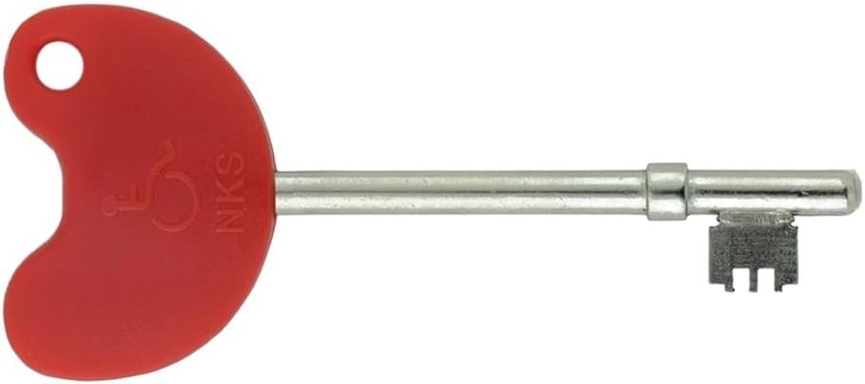
Radar Key
If anyone would like one of these Radar Keys, please call into the Lingen Davies to obtain one. All you need is your postcode.

Slide 25
Just to re-cap
3 days of Laxido and Simeticone prior to your CT appointment.
Microlax enema at home 30 minutes before leaving for your CT appointment and on the first day of your Radiotherapy treatment.
Hydrate from today, 1 litre of still water per day, including weekends.

